Slide 1


Understanding and supporting children with behavioural difficulties:
A workshop for parents and carers
Dr Charlotte Morton, Clinical Psychologist
Getting Help and Mental Health Support Team, Slough
With thanks to Dr Deb McNally for some materials prepared for the PPEPCare project

Slide 2

What do you hope to get out of this workshop?
Please type your answer in the chat or unmute

Slide 3
Overview of the workshop
Brief introduction to the Mental Health Support Team (MHST)
What do we mean by behavioural difficulties?
Behaviour as communication
Two hand approach to parenting
Introduction to the ‘Incredible Years’ Parenting Pyramid
Q&A and reflections
Further resources
Understanding behaviour in the context of childhood brain development

Slide 4

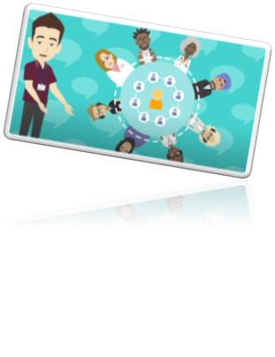
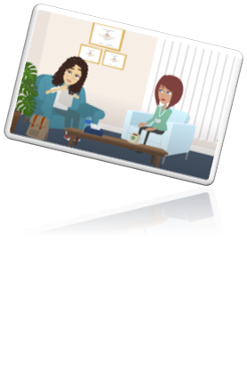
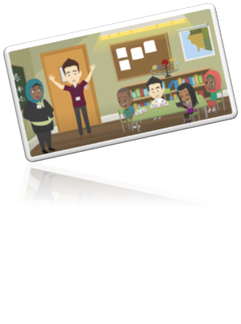
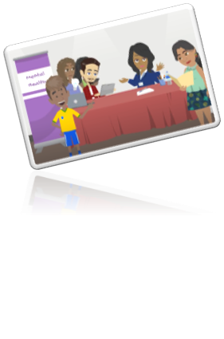
Slough MHST
Who we are

Slide 5
4 x Education Mental Health Practitioners (EMHPs)
Team Administrator
Slough MHST
1 x Clinical Psychologist/ Senior Clinician
1 x Senior Clinical Psychologist/ Team Lead
1 x Drama Therapist/ Senior Clinician

Slide 6
How we offer support
Early intervention and prevention for mild-moderate emotional and behavioural difficulties
1-1 support for CYP (12 years+) and parents (under 12 years) over 6– 8 sessions​
Small group sessions​
Peer mentoring​
Whole school approach activities & integrated working
Education staff training and consultations
Mental health surgeries​ for schools
Parent workshops

Slide 7

What do we mean by “behaviour difficulties”?
Please type your ideas in the chat or unmute

Slide 8


Childhood behaviour difficulties
Childhood is characterised by huge developmental changes for children
Within normal development, children display many behaviours that parents find stressful (e.g., temper tantrums, aggression & non-compliance)
However, for some children, these behaviours are more persistent and become a problem (e.g., if they are impacting on the child’s functioning or affecting the child and/or family’s quality of life)
Notes:
The main thing to emphasise here is that childhood is a time characterised by enormous developmental changes for children, physically, cognitively and emotionally. Within normal development, children display many behaviours that parents find challenging and stressful (e.g., temper tantrums, aggression and non-compliance). Parents can seek help and reassurance from professionals as to whether the behaviour is acceptable for a child of that age. However, many of these behaviours are transient and should be viewed as part of normal development rather than pathologised.
For some children, however, these behaviours are more persistent and may become a problem. When the behaviour becomes more persistent, and starts interfering with different areas of life is when it may need to be taken more seriously.

Slide 9

What things seem to make your child’s behaviours increase/worse?
Please type your ideas in the chat or unmute

Slide 10

What things seem to make your child’s behaviours decrease/better?
Please type your ideas in the chat or unmute

Slide 11
The ‘Behaviour Cake’
Parental physical & mental health
Child’s physical health
Child’s temperament
Parenting behaviour
Lack of sleep/fatigue
Speech/ hearing problems
Genes
Environment
Early adverse experiences
Developmental delay
Other?
Medication
Notes:
Kids behave in the way they do for many reasons and we do not have direct influence over most of them. Lots of things may have happened in the past that we cannot change. However, the one thing we can change and have direct influence over is our own parenting behaviour. That is not to say we are to blame for our children’s difficult behaviour, but it is the one thing we can change to influence their challenging behaviours. Remember that changing one ingredient on the cake makes it a completely different cake (what would happen if you forgot the flour??).

Slide 12
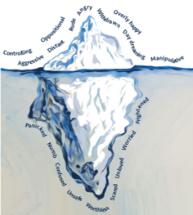

Behaviour as communication: bringing hidden needs to the surface
To help your child to feel calm and to get closer to them, respond to them as if you could see their hidden needs rather than the behaviours you see.
Ask yourself:
  What might be the function behind this behaviour?
  What does this behaviour help my child to achieve?
  What might my child be most frightened of in this moment?
Image credit: Beacon House Therapeutic Services & Trauma Team
Notes:
People of all ages find ways to manage their emotions so that they feel as protected and safe as possible – it is human instinct to do this. We guard ourselves against feeling too vulnerable by showing the world behaviours that keep others at a safe distance – our real needs are often buried deep below the surface where they are hard to see.
To help your child to feel calm inside and get close to others, could you respond to them as if you were responding to their hidden needs rather than the behaviours you see? Would your response look different? Do you think you would feel differently if you could see their hidden needs? Can you show them empathy, acceptance, understanding and kindness, even when their behaviours are pushing you away?

Slide 13
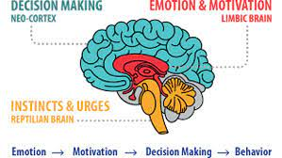
Childhood brain development
At birth, we have the reptilian brain (the brain stem), which controls many subconscious body functions (e.g., breathing, body temperature) and the limbic system, particularly the amygdala, which deals with threat, danger and emotions.
Around age 10-12, the temporal lobes start to function like a radar.
The prefrontal cortex, responsible for higher-order cognitive processes and executive functioning (e.g., planning, impulse control, empathy, decision-making, problem-solving), is not fully developed until the mid-20s.
Notes:
At birth, centres deep inside our brain are functioning, including the brain stem hich controls subconscious bodily functions and the limbic system, particularly the amygdala, which is like the brain’s alarm system that detects signs of threat and danger. By the end of primary school, other parts of the brain around the side of the brain, called the temporal lobes which are connected with memories, start to function like a kind of radar, so they take in information from other people and compare it to scripts/stories about how people should behave in this situation. If the way people behave doesn’t fit with my story, then we switch on our emotion centre and may get alarmed, anxious, angry, upset. The frontal part of the brain was the last part to evolve and so it’s also the last to mature and doesn’t reach adult maturity until around the age of 22-24. The prefrontal cortex is responsible for what we call higher-order cognitive processes and executive functioning, such as planning, controlling impulses, empathising, decision-making and problem-solving.

Slide 14
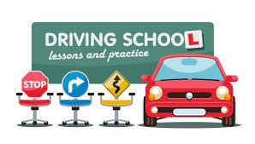

We can think of the child’s brain as a car…
A primary school-aged child has a powerful engine (the emotion centre of the brain)
By age 10/11, the accelerator pedal is functioning reasonably well (the detector part that can tell when people are going off script based on memories of similar situations)
However, the braking system is only half-ready, so it can be very hard for the child to stop and think when the engine is revving and they are accelerating hard (i.e. experiencing big emotions).
Notes:
So… your child needs you to be like their driving instructor, you may need to guide them to help them to apply the brakes (or occasionally you may need to perform an emergency stop) when their engine and accelerator are too powerful!

Slide 15
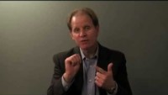
So, your child isn’t ‘mis’behaving on purpose, they are just operating from their “downstairs brain”…
Notes:
Parents often hold the belief that their young child is misbehaving on purpose or sometimes that they have callous intentions, such as wanting to upset the parent or other children, or they believe that the child should have greater self-control. This is something that Claire Lerner refers to as a “faulty mindset” as this mindset can lead parents to behave in a more harsh and punitive way in response to their child’s behaviour rather than recognising that the child is likely functioning from their “downstairs brain” that is driven by impulses and emotions, so they are not able to stop and think about their feelings (at least not in a moment of emotional dysregulation).
https://www.youtube.com/watch?v=gm9CIJ74Oxw

Slide 16
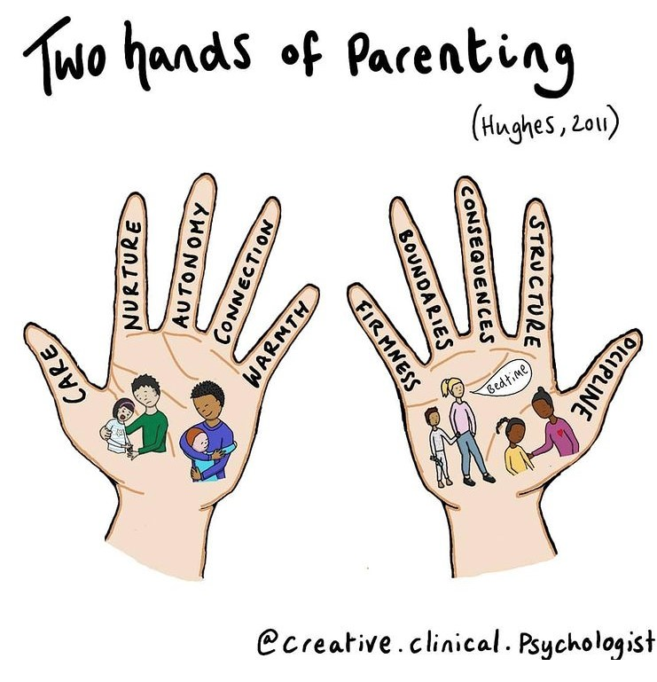
Notes:
We need try to strike a good balance between the two hands of parenting!

Slide 17
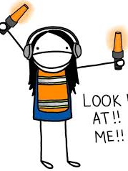
Children’s learning: the basics
Fundamentally, children want attention from their parents and from other people.
Children typically learn by copying/experimentation.
Behaviours that are reinforced are more likely to occur (conditioning).
Behaviours that are ignored (i.e., not reinforced) are less likely to occur.
Conditioning is the pairing of the reinforcer (stimuli) with the behaviour a child displays.
Notes:
Attention is a basic survival need and shows children they are loved and that people want to spend time with them - investing that time with children can lay a strong foundation to help bounce back from difficult times

Slide 18

Children’s learning: the basics
Any reaction/ stimuli that encourages a behaviour is known as a positive reinforcer.
For young children, parental attention is one of the most powerful reinforcers.
The child will repeat the behaviour to gain further positive reinforcers from the parent.
Even negative responses (e.g. shouting etc.) can be positive reinforcers (i.e., make a behaviour more likely to be repeated).
The removal of an aversive stimuli is known as a negative reinforcer.

Slide 19
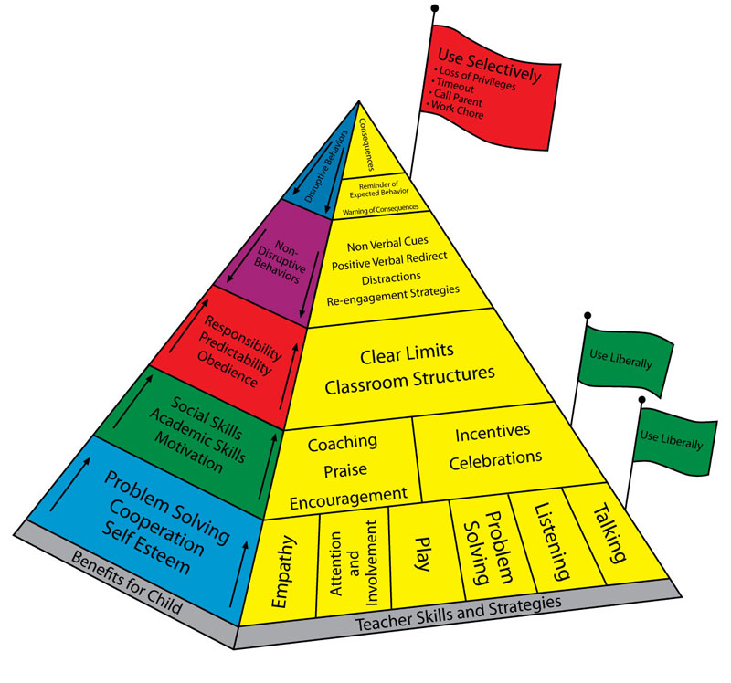
Introduction to key principles of the ‘Incredible Years’ parenting pyramid
Developed by Carolyn Webster-Stratton
Notes:
Note that with this approach things might get worse before they get better - children have been used to getting things a certain way for some time and they won’t like that things might be changing, but with commitment to the strategies it will get easier

Slide 20
Put simply …
(or “Time-in”)
Notes:
These are the elements that are seen as necessary to help parents change their children’s behaviour. You will notice that play has the most blocks, then praise has the next highest amount. This is because these are seen as the most important elements and have to be started first. These are where the parents learn to give lots of attention to their children for behaviours that they want to see more of. Only when the parents are good at this can they move onto the next level of the pyramid (ELS –effective limit setting) to set effective limits and withdraw their attention through ignoring for behaviours they want to see less of.

Slide 21
Play
Do let the child lead the play
Do show interest and use descriptive commentary & supportive comments
Do give your child your undivided attention
Avoid teaching or giving commands
Avoid questions
Avoid criticising or competing
Aim for at least 5-15 minutes per day
Notes:
So we’ll be talking about play first – the importance of this in terms of building a positive relationship which is the foundation of all parenting work…
Descriptive commentary refers to the parent just commenting on what the child is doing when playing. Can comment on the action, cognition or emotion e.g.
Action: “You’ve got the red brick now and you’re balancing it on top of the blue one’
Cognition: “‘You’re thinking really hard about how to fit that together’ or “‘that looks so tricky, but you’re sticking with it and working it out’
Emotion: “You look so proud of your tower, you have such a lovely smile on your face” or
It is really helpful to just demonstrate what this looks like for a minute or so – get down on the floor if necessary! e.g., I see you’re playing with the blocks, - putting the blue block on top of the green block and now the red block – wow it’s getting really high.
In this way the child feels like they are getting lots of attention. The person they want attention from most in the world is describing what they are doing – they love this and it starts to get them used to lots of positive attention, so as we move higher up the pyramid and remove it later when ignoring they really will notice the difference.
Research indicates that it promotes creativity and emotional well-being.
Can also be very effective with adolescents, e.g. when they are playing a game on the X-Box – a source of validation
The next step of the ladder is praise

Slide 22

Praise
Do wear “rose-coloured spectacles”.
Do use specific & labelled praise, and praise the behaviour you want to continue
Do use a warm voice.
Do praise immediately.
Do try to model (e.g. “thank you!”)
Avoid “stings in the tail”.
Avoid waiting for perfection.
Notes:
What is praise? A thumbs up, a friendly smile, a hug, “Well done!”, Thank you for doing that”
The general intent is to provide positive feedback, encourage, and support the occurrence of the target behaviour (e.g., sharing, accurate performance, sticking to a task).

Slide 23
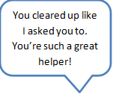









Praise
What’s wrong with …
Compared to…

Slide 24
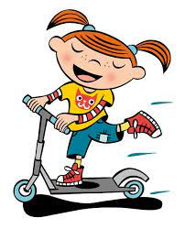
Rewards
Rewards, incentives and celebrations encourage behaviour we want to see more of
Rewards should be determined ahead of time so your child knows what to expect
You should try to involve your child in choosing the rewards
Rewards do not have to be expensive
Do not take rewards away as punishment
Rewards are not the same as bribes as they are earned after the good behaviour occurs, whereas a bribe is offered to avoid an undesirable behaviour or are negotiated by the child to persuade good behaviour
Notes:
Rewards should be desired by your child
Be clear about how many behaviours your child needs to display to obtain a reward
Could be going to the park or riding their scooter to school – doesn’t need to be expensive

Slide 25
Effective Limit Setting (ELS)
Gain eye contact
Give one command at a time
Use appropriate language
Use a firm voice
If you repeat, use the same words.
Use “when - then” commands.
Praise/reward as soon as compliance is achieved
Remain calm
Notes:
Important not to say ‘if you do x then y will happen’ as this implies there is an option not to do it. Say instead when you do x then you can do y
Make sure that you thank and praise the effort even if the child is making a song and dance about doing it (e.g. stomping around before putting shoes on). Don’t wait to praise until the behaviour is completed – praise the process/when they start doing it.

Slide 26
What makes it difficult for you to set limits (or hold your limits) with your child?
Please type in the chat or unmute

Slide 27
Top tips for ELS
Give children alternatives and choices. E.g. “You can’t watch TV right now, but you can play with this jigsaw or you can play in the garden”
Use clear logical consequences e.g. “when… then …”
Do not give commands constantly, use sparingly and one at a time
Its important to stay calm
Pick your battles, save “No” for when you really mean it or the situation is not negotiable.
Be consistent (including between parents)
Boundaries should not be dependent on your child’s agreement with them
Notes:
Firm boundaries help children feel safe and give guidance about what behaviour is expected of the child.

Slide 28

Selective Ignoring
Ignoring is the complete removal of attention e.g., in response to tantrums, screaming, shouting, swearing, spitting, name calling.
To ignore properly there are 3 rules:
  NO eye contact
  NO talking
  NO touch
Do not ignore behaviours that are destructive to the child, other people or property, or behaviours where they may get attention from others (e.g. a tantrum on the bus)
Notes:
This may be very difficult to do, particularly in public places where people are watching and expecting a parent/carer to be telling a child off

Slide 29

What makes it hard to ignore your child’s behaviours?
Please type comments in chat or unmute yourself
Notes:
Parental mood
Environmental context
Onlookers!
Belief in the strategy “it looks like I’m not doing anything and how will my child know that is not the right thing to do?”
Tried it before and it’s not worked
Not completed the earlier stages of the pyramid i.e., play & praise

Slide 30
Ignoring - top tips
Identify a specific behaviour to consistently ignore
Utilise your own ‘stay calm’ strategies!
Praise the child immediately when they re-engage in positive behaviours and redirect
Be prepared to be tested!
Be patient and persist until the misbehaviour stops
Ignoring only works well if the foundations of pyramid in place
Notes:
Example:
Parent: “I’m sorry there is no time to play your games before dinner as we only have 10 minutes till it’s ready” (limit is set).
Child: “But I want to go, you’re not being fair. I will be back before dinner.”
Parent: “I know you are upset about this, but the answer is no, I am sorry.” (Recognising the emotion)
Child: “I hate you. I am going to go anyway. You are stupid.”
Parent: Ignores argument

Slide 31

Time-out
“Time-out” refers to time out from any attention/reinforcement for a brief period (e.g., 3-5 mins) to allow them to calm down in a non-threatening environment.
This technique should be used sparingly, such as for dealing with challenging behaviours e.g., when child is being aggressive to other children/adults or being destructive.
Choose a safe but boring place (e.g., not a room full of toys andTV), but may have access to sensory regulating objects (e.g., fidget toys, weighted blanket)

Slide 32
… or Time-in
Alternatively, might be called “calm time” or “safe-space break”
“Time-out” is sometimes seen as a controversial parenting method as it is often associated with punishment. Research also suggests that young children have a very limited ability to self-regulate their emotions and need their parent(s) to act as “co-regulators”. The antidote to “time-out” has become “time-in”, which entails staying with the child throughout the meltdown and doing a regulating activity together.
You know your child best and what helps to sooth them – whether that is time away from you or with you. The most important thing is that the break is implemented calmly and lovingly by the parent/carer, not punitively.
For example, “Wow, I can see you are so angry right now, I think it would be a good idea for us to go to your calm space to cool off” rather than “go to your room right now and think about what you’ve done!”
Notes:
Problem is that time-out is often associated with punishment and “naughty step”. A robust body of research clearly shows that the part of the brain that controls the ability to think about and manage feelings and actions is not well-developed in young children. They are driven by their feelings and impulses. They are not misbehaving on purpose, so they don’t tend to learn anything from time-outs. The antidote to time-out has become time-in, which entails staying with the child throughout the meltdown, no matter what. Parents act as “co-regulators”, providing the support young children need to soothe themselves given that they have very limited ability to self-regulate. However, there may be times when children are so out of control that they cannot accept comfort and the more you try to calm them, the more out of control they get – you know your child best and what works for them.
Breaks are not inherently or necessarily harmful to young children: it’s all in the way they are executed. When parents approach the break calmly and lovingly—not punitively ("Go to your room right now!”)—this tool can be caring, not callous. It creates the space parents and children need to prevent further escalation, and to come back together to solve the problem when they are both calm.
Important to implement the break in a supportive and loving way: 1) let your child know what the plan will be when in the red zone, 2) make sure the safe space has a boundary to prevent child exiting on own, 3) include your child in designing the space, 4) stay as calm as possible when moving your child to the calm space, 5) choose time limit appropriate for your child
See Claire Lerner webpage for more detail: Time-Out 2.0: When “Time-In” Doesn’t Work, Giving Your Child (And Yourself!) A Break Can Be Helpful, Not Harmful — Child Development and Parent Consultation (lernerchilddevelopment.com)

Slide 33
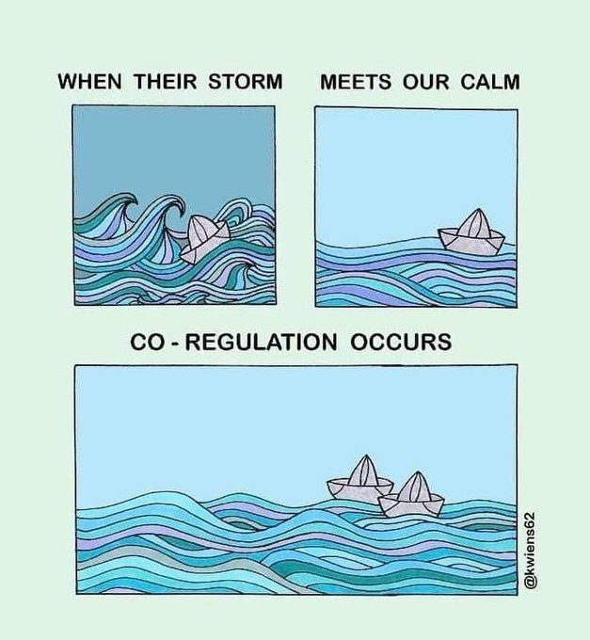
Parents need ‘time-out’ too!
Looking after yourself and managing your own emotions is one of your most important parenting tools!
Get to know your triggers - anticipate what kinds of situations and behaviours get you revved up and provoke you into being reactive (e.g., yelling, threatening, bribing, shaming).
Responsive parenting means considering what the child’s behaviour is communicating and what they need to cope – this requires an ability to calm our own bodies and minds when we get triggered by our child’s behaviour!
Notes:
Reactive parenting is when we get triggered and act on our emotions without thinking through what our children’s behaviour is telling us and what response is going to teach them positive ways to cope with whatever need they are trying to meet or challenge they are facing. Reactivity usually leads to an escalation of the problem and more stress and frustration for both parent and child. It is really hard not to be reactive. Parenting is by nature a highly emotional endeavor that stems from our deep love for our children and the accompanying worry for their well-being. Young children are driven by their emotions and behave in irrational, maddening and often confusing ways that most parents have no roadmap for navigating.
Being responsive, which means taking into consideration what we know about our children, what their behaviour is communicating, and what they need to cope. This requires mindfulness — the ability to calm our minds and bodies when we get triggered by a challenging behaviour so we can think about our feelings and reactions and then choose a response that we believe (and hope!) will help our children learn positive ways for getting their needs met.
This approach enables you to be responsive, not reactive, and is as important for you as your child, as it prevents you from behaving in ways you feel bad about and regret. It also helps your child learn to make good choices.
See blog post for further detail: Responsive vs Reactive Parenting: It Makes All the Difference — Child Development and Parent Consultation (lernerchilddevelopment.com)

Slide 34
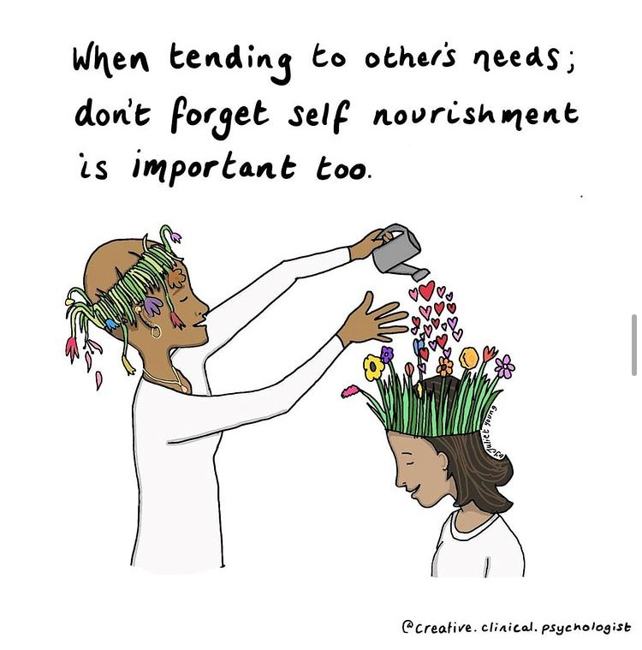
What do you do to look after yourself and manage your emotions?

Slide 35

Any questions, comments or reflections?

Slide 36

If you are concerned about your child’s emotional or behavioural difficulties …
Please discuss with your child’s Class Teacher or Mrs Clarke who can support you to make a referral to the Mental Health Support Team

Slide 37


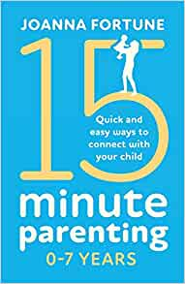
Further reading
Notes:
Claire Lerner also has lots of great blog posts on her website: https://www.lernerchilddevelopment.com/blog-2 and a great podcast episode called “Why is my child in charge?” available on “Raising Little Humans” podcast

Slide 38








Other resources & helpful contacts

Slide 39
Please take a moment to share your feedback about how you found this workshop & suggest any ideas for future workshop topics…
https://forms.office.com/r/1wQYLXc7NV
Thank you!
Notes:
https://forms.office.com/r/1wQYLXc7NV

