Slide 1
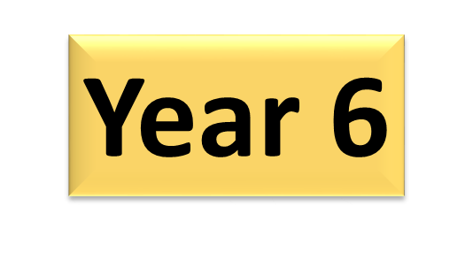
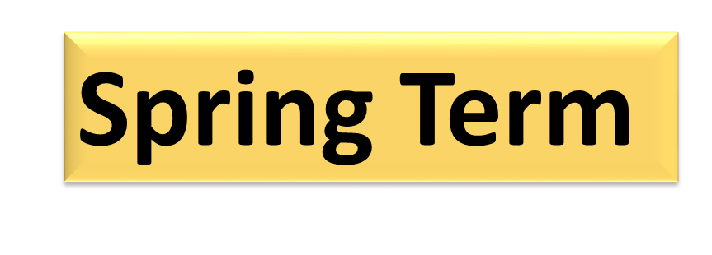
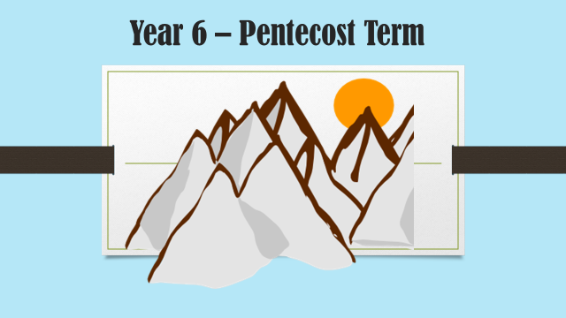

Slide 2
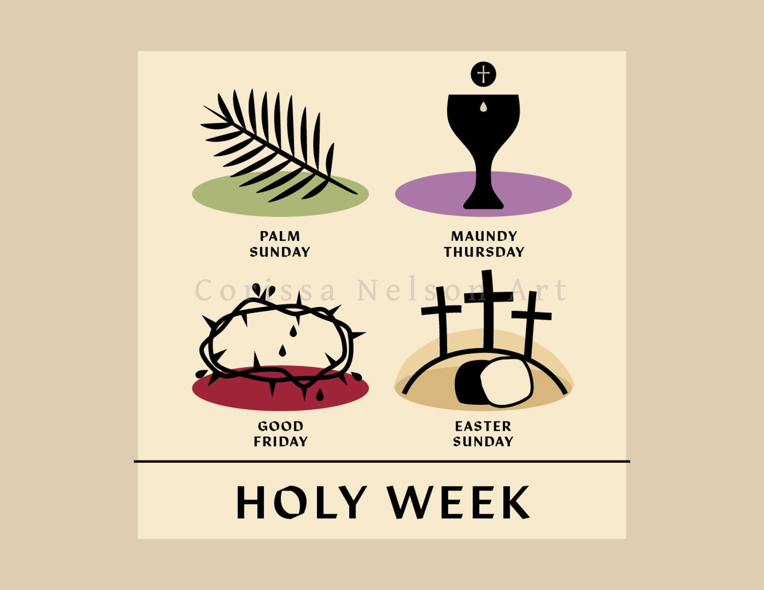
Religious Education
We will cover two topics this term. This half term’s RE topic is called Galilee to Jerusalem, and will focus on John’s Gospel. The children will learn about Jesus’ seven miracles and seven I am statements. They will all contribute to our class floor books as we reflect on what we have discussed during the lessons.
In the second half term, we will focus on Holy Week and the lead up to Easter. The children will also attend an afternoon of reflection and Easter Activities at Langley Free Church.

Slide 3
Maths
This term Year 6 will be focusing on consolidating our understanding of place value, ordering numbers and rounding numbers up and down.
We will also develop our understanding of both the written and mental strategies for addition, subtraction, multiplication and division.
There will be a focus on fractions, decimals and percentages, where the children will be identifying the links and relationships between them.
We will discuss and sort two and three dimensional shapes according to their properties. There will be a special focus on quadrilaterals. We will be finding the area and perimeter of triangles and parallelograms. The children will also be introduced to simple algebraic calculations.
1
3
During the course of the school year we will be focusing on the application of times tables, up to and including the 12 times table. We ask that you practise times tables with your children, ensuring that they can respond confidently – even when asked at random. This will support your child in all areas of mathematics.
2

Slide 4
Literacy
During the course of the term, the children will be focusing on improving their understanding of grammatical structures through the use of: complex and compound sentences, expanded noun phrases and figurative language.
There will be focus on developing the use of higher level punctuation, including brackets, dashes, semicolons, commas and many more!
It is essential that your child is provided with a suitable fountain pen in order for them to produce their best work.
This term the children are going to be focusing on the picture book: The Journey. They will be writing descriptive narratives, informal and formal persuasive letters and balanced arguments. The children will be given the opportunity to take part in role-play and performing oral poetry to support the development of their writing.
Reading At Home
It is vital that your child reads at home to help the development of their reading comprehension, writing and grammar skills. We ask that your child records at least 5 entries into their homework diaries. Remember – children are never to old to be read to!

Slide 5
Science
This term the children will be studying three topics in Science.
Light
Children will recognise that light appears to travel in straight lines and use the idea that light travels in straight lines to explain that objects are seen because they give out or reflect light into the eye. The children will create shadow puppets to explain why shadows have the same shape as the objects that cast them.
Animals including Humans
In this topic the children will be learning about the main organs of the human body, including a detailed study of the heart.
The children will explore the importance of a healthy diet and the benefits of exercise to our bodies.
Electricity
During this topic the children will be exploring the way circuits are built and how diagrams are used to record these.
They will complete a range of experiments, including how to identify insulators and conductors.
Useful Website
http://www.bbc.co.uk/bitesize/ks2/science/physical_processes/circuits_conductors/play/

Slide 6

Year 6 Computing Spring Term
Algorithms / Programming and Development
The children will learn continue to develop their programming knowledge.
In Scratch they will design and create an animation working on the use of purposeful algorithms. They will use control and events that make the most impact. The children will be evaluating the quality of their programmes and identify areas for improvement.
In Espresso Coding they will learn to use variables in more complex ways, and to manipulate inputs to create useful outputs. Then they will develop more knowledge about how computers use property values and parameters to store information about objects

Slide 7

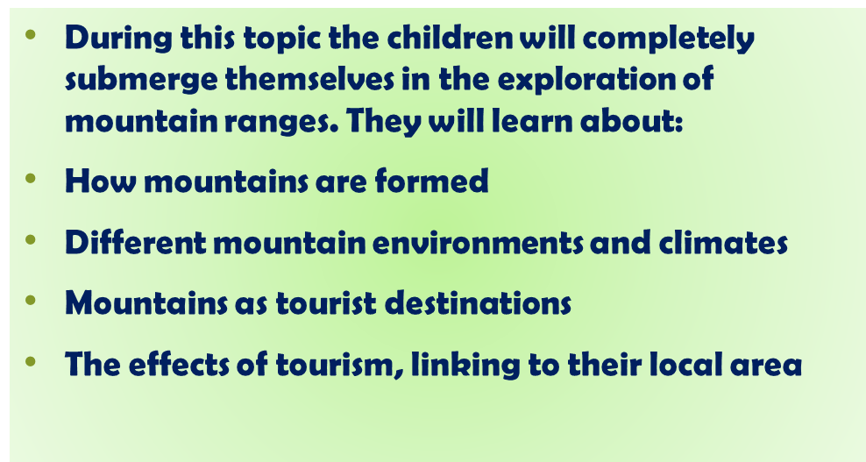
Geography
Mountains
Rivers
We will be looking at features of rivers, the stages of a river’s journey, how altitude and channel width can affect river processes. We will be looking at how rivers are used and can be developed for the benefit of humans living in that area focusing on The Amazon, Volga and Thames.

Slide 8

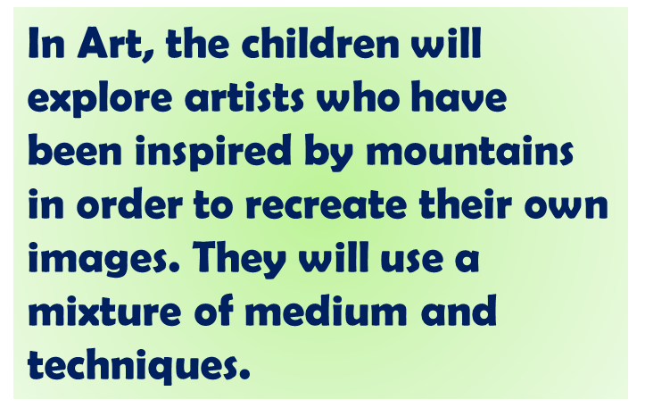
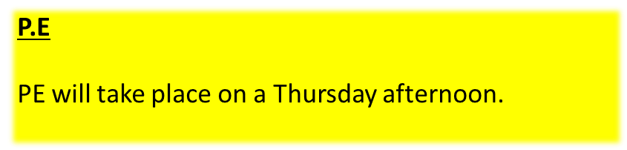
Music
The first half term is focused around: You've Got A Friend by Carole King
They will learn to sing and perform the song on glockenspiels and recorders with paying attention to the dimensions of music (pulse, rhythm, pitch etc).
The second half term is Music and Me focusing on inspirational women working in music, and part of Brighter Sound’s pioneering gender equality initiative Both Sides Now.
Throughout this series, the children will explore the concept of ‘identity’ – the various elements that shape us. In this unit, we start with gender, with reference to social and cultural differences.
They will be invited to try out different ways of making their own music, while exploring the work of some of the most influential women in music over the last 100 years.

Slide 9
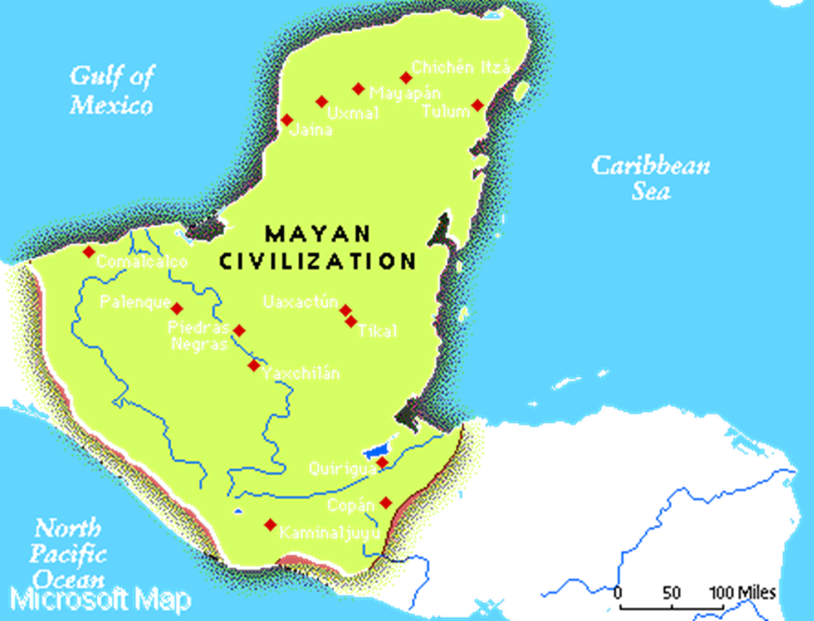
Additional Information
Dates for the Diary
Friday 13th February: School closes for half term
Thursday 5th March: World Book Day
TBC: Easter Cracked visit
Friday 27th March: School closes for Easter
P.E.
The children will be having their P.E. lesson on a Thursday afternoon. Any child who has their ears pierced will need to remove them prior to the lesson.
Spelling
We as that you work through any spellings your child is given, as well as continual focus on their high-frequency spelling words. A list of these will be sent out before half term.
Homework
Maths and Literacy homework will be set on a Friday and due in by the following Wednesday. We expect all homework to be completed to a high standard and to be given in on time. The children will be given time to write their homework into their homework diaries and we ask that you sign these weekly once your child has completed their work. These are checked on a weekly basis and can also be used to record any independent reading that your child may do, or any reading with an adult (we would ask that you try to read with your child twice a week).
Year 6 learning is about preparing your child for secondary education, therefore we ask that you try to encourage your child to be as independent as possible (being responsible for packing their school bag, allowing them to come into class alone in the morning, etc.).

