Slide 1
Year 5
Lent 2026
Curriculum Map

Slide 2
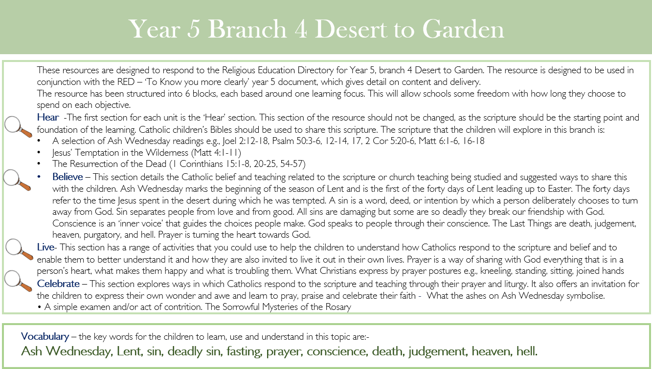
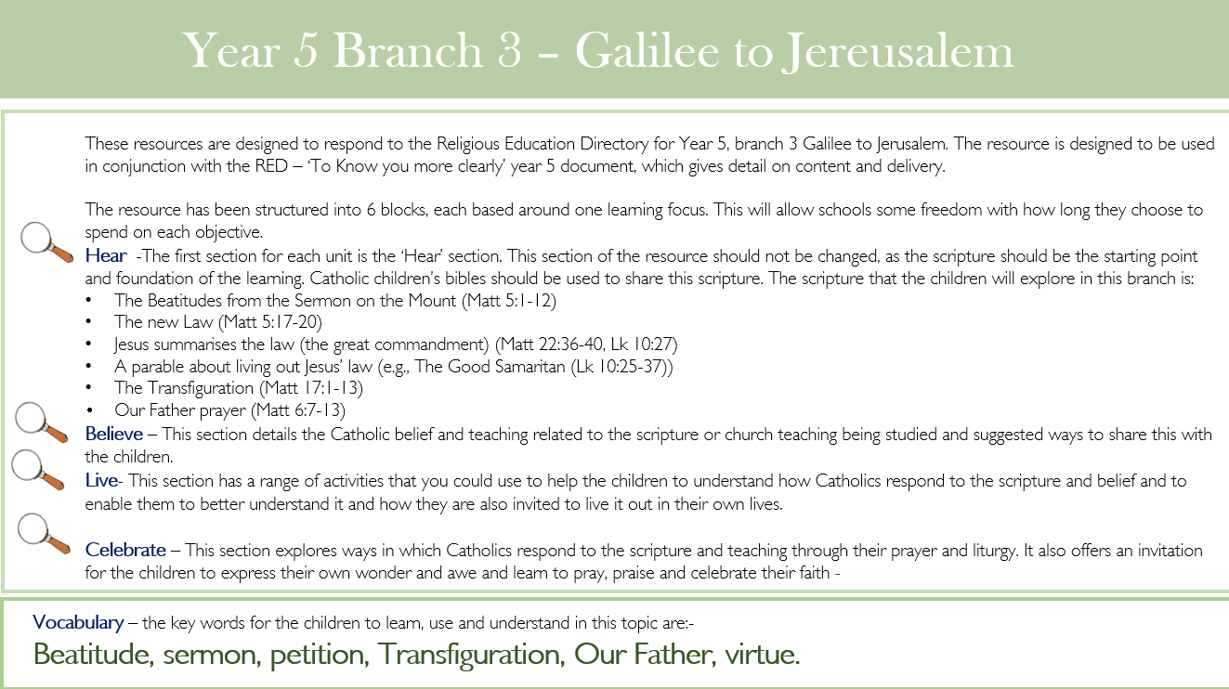
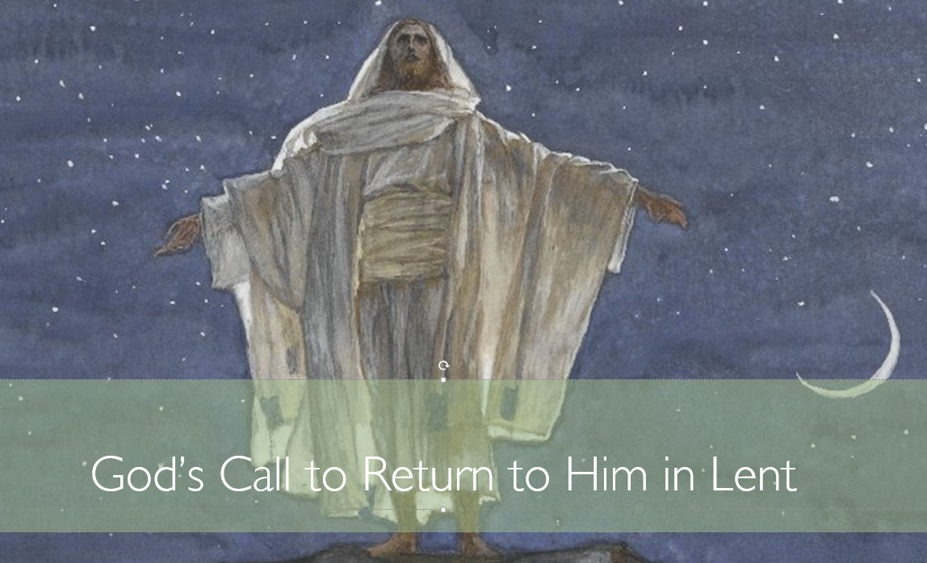
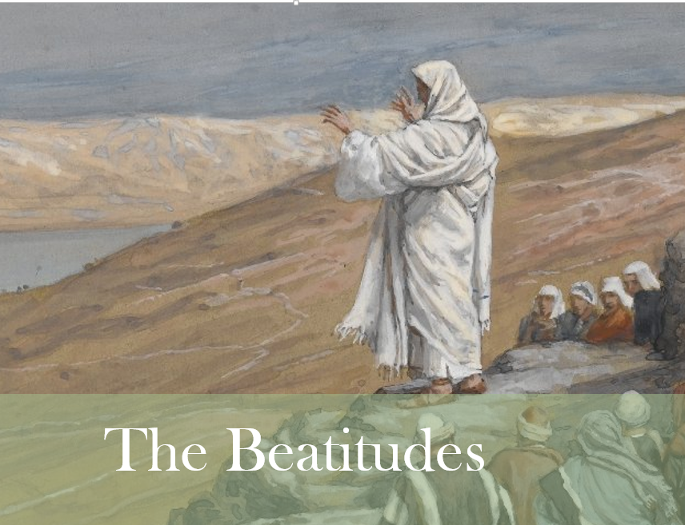
RE
Topic 4 – Galilee to Jerusalem
.
Topic 5 – Eucharist

Slide 3


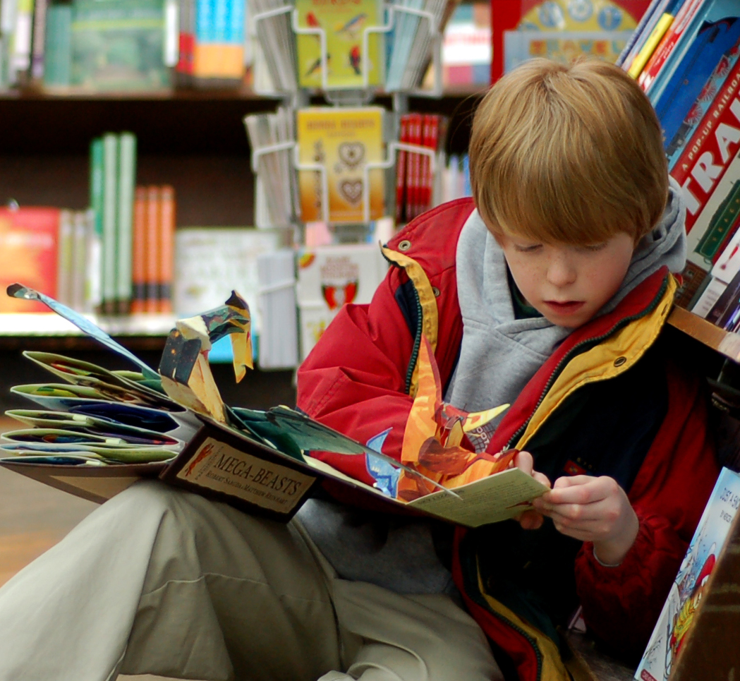
English
This half term the children will be studying Anglo-Saxon Boy, the story of Magnus Godwinson who finds himself cast into the centre stage of a blood-soaked family feud that led to one of history’s most famous battles! This is story of the family tragedy behind 1066.
In Lent 2 we will be reading Cosmic, a humorous adventure story told in the voice of twelve year old Liam Digby a ‘gifted and talented’ child whose physical appearance ages him beyond his years. We will follow Liam and his friend, Florida Kirby on this humorous, action packed adventure exploring the ups and downs of being a parent and the consequences of a ‘little white lie’.
Overall learning aims of these teaching sequences are: • To consider how particular situations make individuals behave as they do • To explore dilemmas, empathising with characters • To build an imaginative picture of a fantasy world, based on real life experiences
Reading At Home
It is vital that your child reads at home to help the development of their reading comprehension, writing and grammar skills. Remember – children are never to old to be read to!

Slide 4

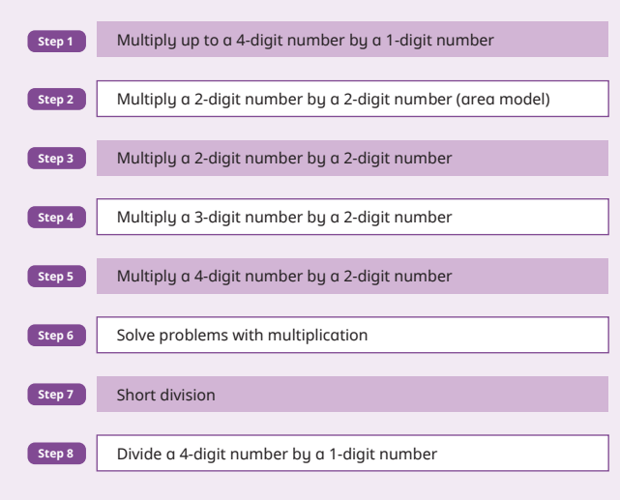
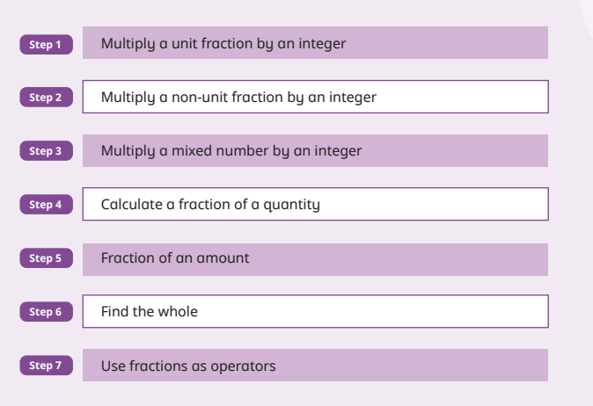
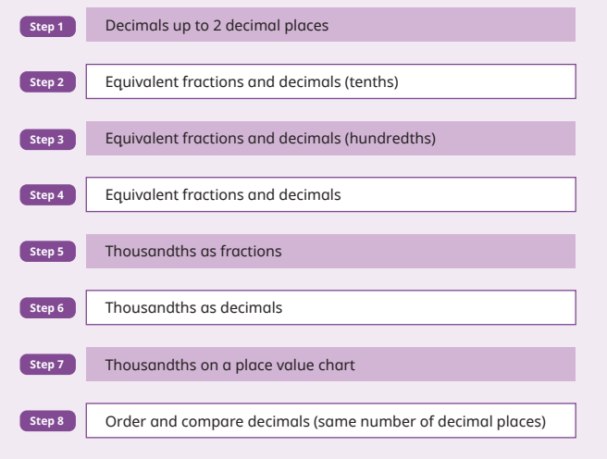
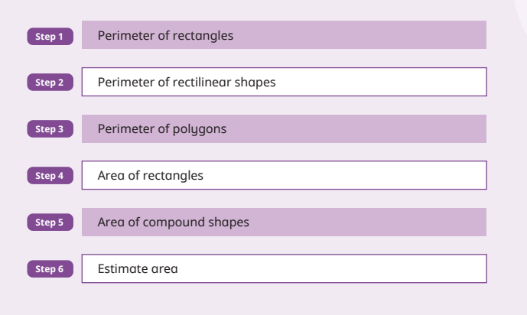
Mathematics
In Year 5, children will continue to practise mental and written calculation methods and use all the operations to solve problems.
They will meet prime, square and cube numbers, and work with factors and multiples. They will calculate perimeters and areas, draw and measure rectangles and rectilinear shapes.
They’ll be taught long multiplication and multiply four-digit by two-digit numbers, then short division for dividing four-digit by one-digit numbers. They’ll begin to multiply fractions, learn more about decimals and be introduced to percentages.

Slide 5
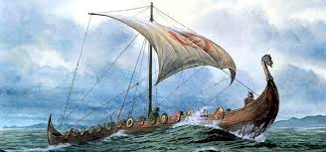
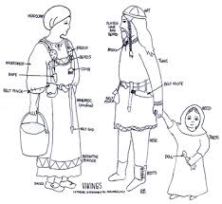
The Anglo- Saxons and Vikings
This half term, Year 5 will be learning about the Anglo- Saxons and Vikings
The children will find out who they were, where they came from and what made them successful. They will learn about Viking trade routes, as well as where the invaders settled and the significance of town names. They will look at everyday life, as well as learning about dwellings and farming. The children will learn about Viking long ships and why these were so successful. All of the work completed will enable them to answer the end of topic question –
‘Both the Anglo-Saxons and Vikings have made a lasting impact on Britain today. Do you agree?’

Slide 6
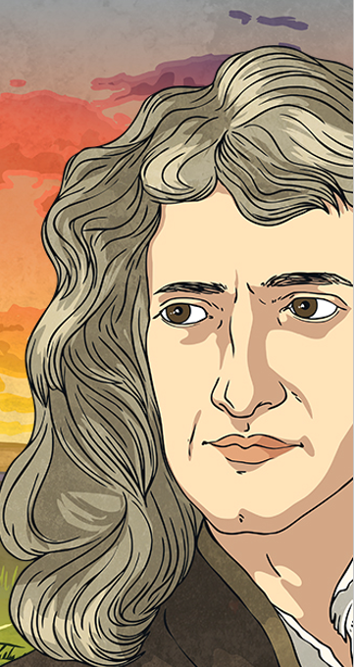
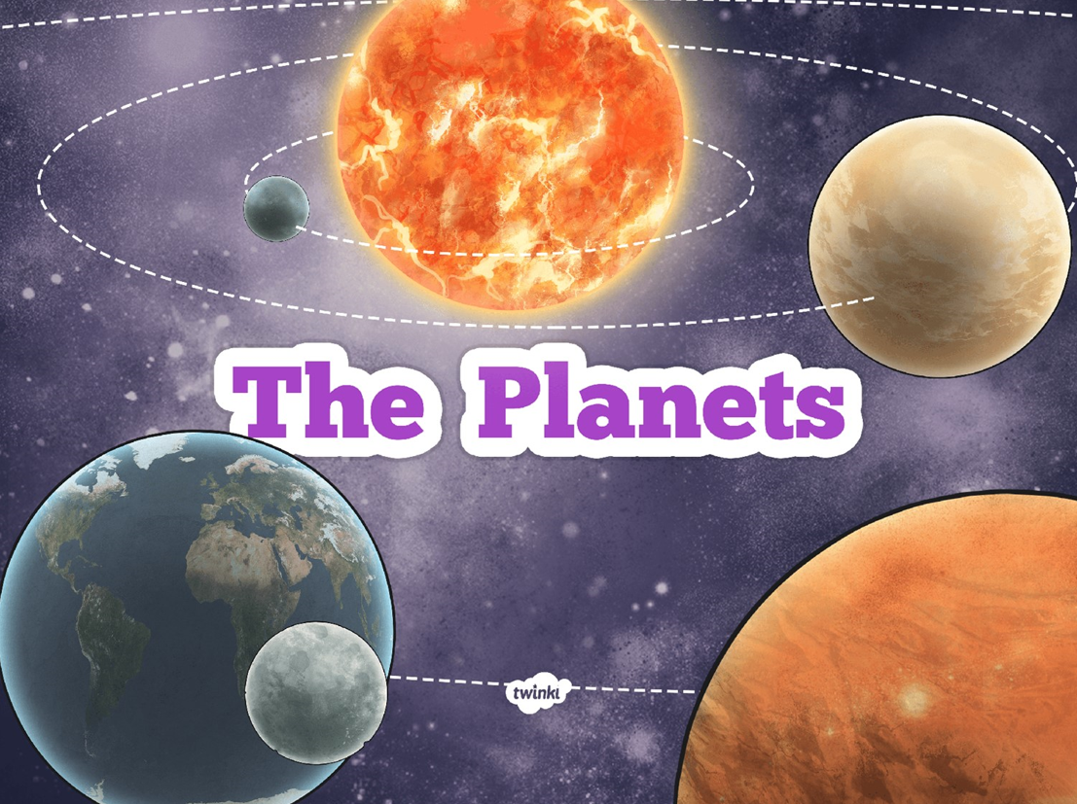
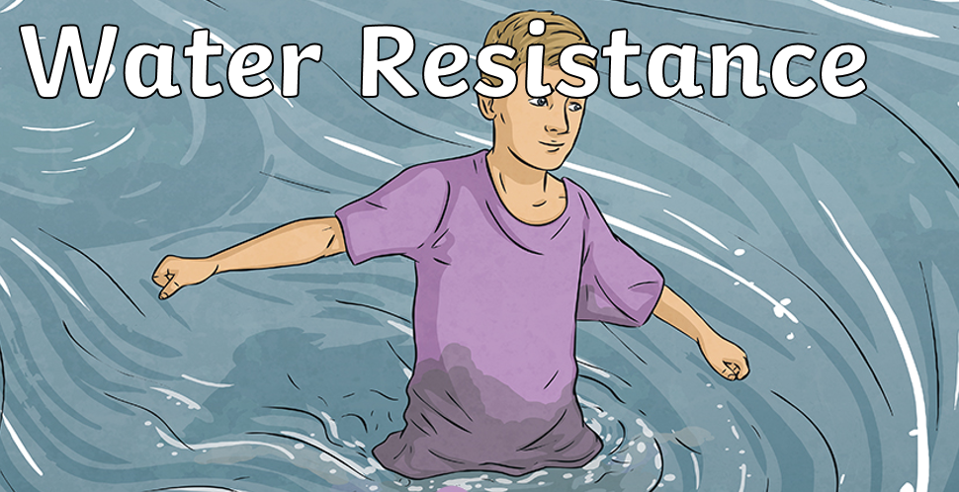
Science
The children will be learning to identify that effects of air resistance, water resistance and friction as well as studying the Earth and it’s place in our Solar System. They will be asking questions that can be investigated scientifically. They will be planning fair tests and repeating observations and measurements in order to improve their accuracy.

Slide 7

Flat-file databases
This unit looks at how a flat-file database can be used to organise data in records. Learners will use tools within a database to order and answer questions about data. They will create graphs and charts from their data to help solve problems. They will also use a real-life database to answer a question, and present their work to others.
Programming
The children will be using Scratch to learn about, creating and editing algorithms to create a maze game.

Slide 8
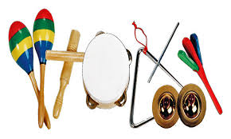
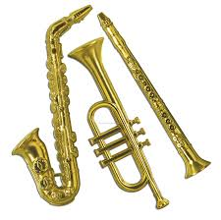
Music
In music, we will be furthering our understanding of different timbres and how they are produced. We will be exploring different ways of combining these timbres to create the intended effect through listening to, composing and performing vocal and instrumental music.

Slide 9
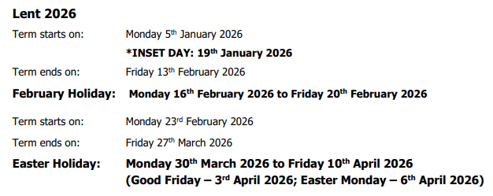
Additional Information
Dates for the Diary
Fire brigade visit: 2.2.26
Class Assembly DOR: 6.2.26
Digital School House:
PF class 26.2.26
DOR class 12.6.26
Circuits workshop: 25.3.26
Stations of the Cross: 24.3.26
P.E.
The children will be having their P.E. lessons on a Tuesday and Thursday. Any child who has their ears pierced will need to remove them prior to the lesson.
Homework - Maths homework is set every Friday on the ‘My Maths’ website and 30 minutes of literacy homework is set on ‘Reading Eggs.’ This homework is to be completed by the following Wednesday.
Spelling homework will be given out on Friday and spelling tests will be completed the following week.
Children are also expected to read and log at least 5 reading entries per week in their Reading Diaries. We also ask that you hear them read aloud at least twice a week and sign their diaries accordingly. Reading Diaries are checked regularly.

