Slide 1
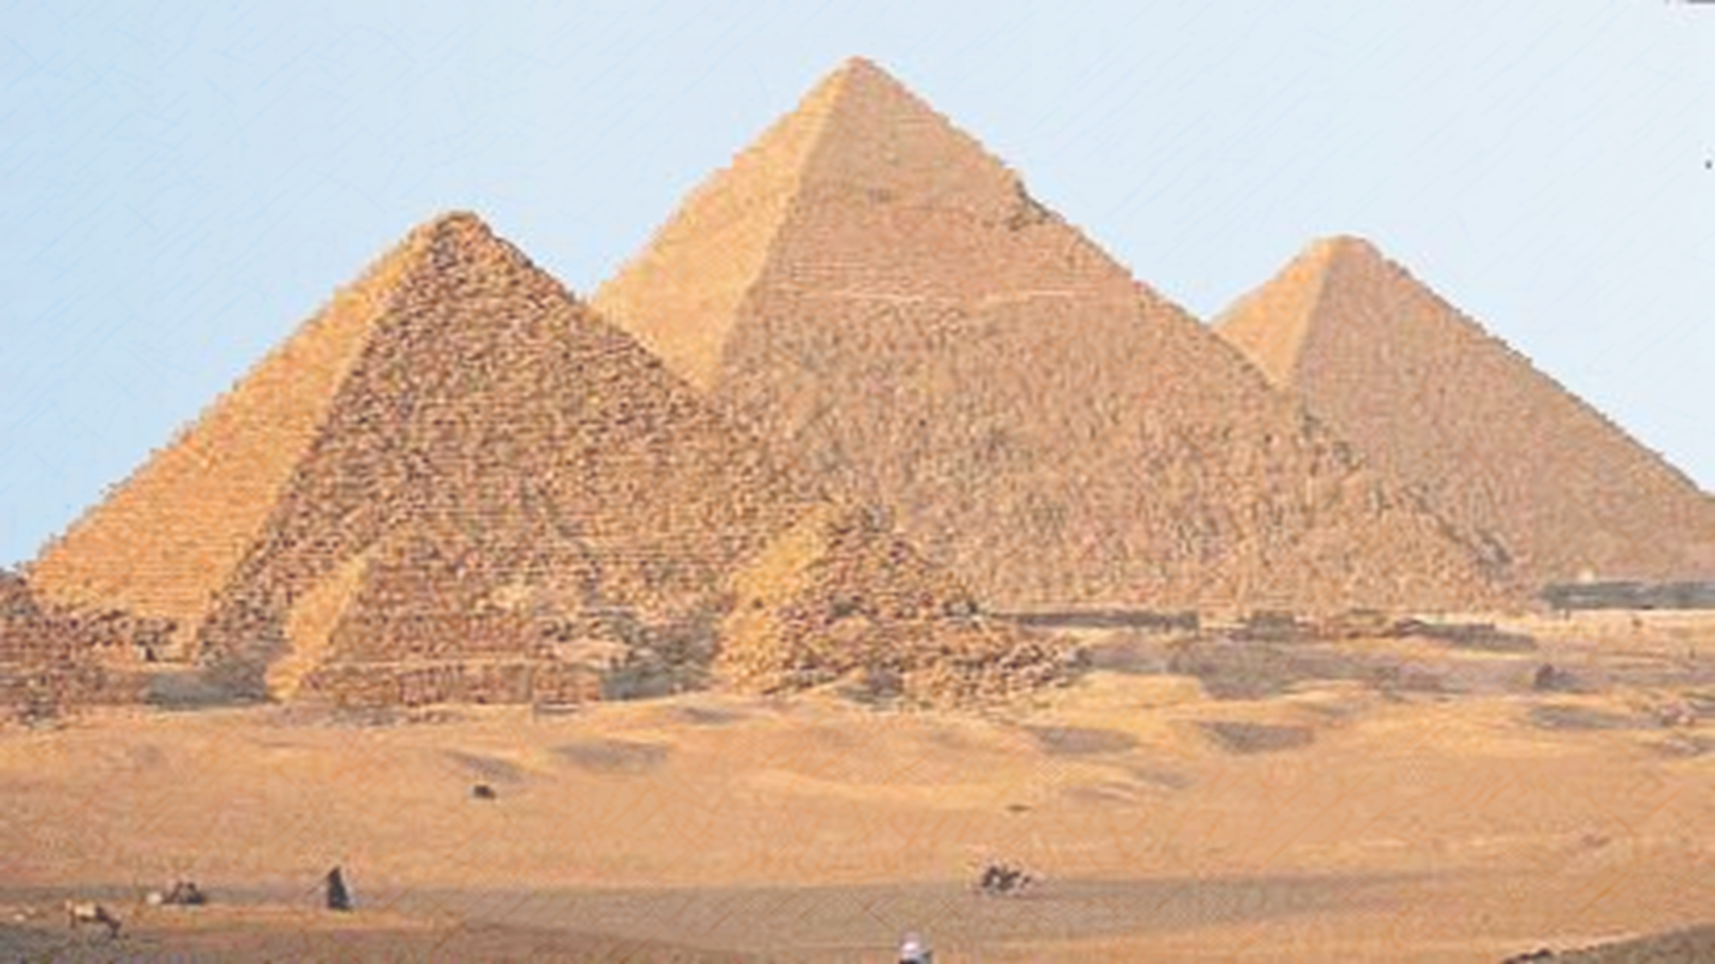
Year 3 Lent Term

Slide 2
English
The children’s writing this year will be inspired by high quality texts from the ‘The Power of Reading’. Through these texts, we will be focussing on writing for a purpose covering: explanations, descriptive writing, persuasive writing, diary entries, letters.
We will then focus on non-fiction writing and learn how bees make honey.
Texts covered:
The Three Billy Goats Gruff by Mac Barnett
Useful websites:
http://www.bbc.co.uk/bitesize/ks2/english/
http://resources.woodlands-junior.kent.sch.uk/literacy/index.htm
https://readingeggspress.co.uk/
https://readtheory.org/
Maths
In Maths we will be continuing to develop both mental and written methods of calculation using the four operations (+, -, x and ÷) using White Rose Maths. This term we will also begin to deepen our knowledge of fractions and perimeter.
In Year 3 children are tasked with learning their times tables. They will have a ‘Times Tables Challenge’ twice a week. Please use TT Rockstars to support your child in learning and practising their times tables at home.
For further support, we encourage the children to use maths websites to reinforce learning and play some fun games. See links below:
http://www.bbc.co.uk/bitesize/ks2/maths/
https://www.mymaths.co.uk/
https://ttrockstars.com/
https://www.topmarks.co.uk/

Slide 3
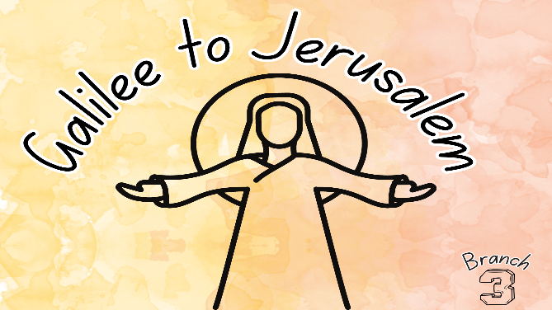
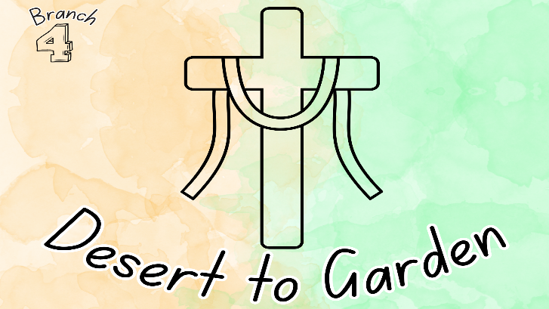
R.E.
To know you more clearly.
Branch 4
Hear -The scripture that the children will explore in this branch is: The miracle of the loaves (Matt • The last supper (Matt 26:26-29). • Extracts from a Eucharistic Prayer
Believe –At the Last Supper Jesus showed his love by giving the gift of himself transformed into bread and wine. He made his apostles priests of his promise when he told them to ‘Do this in remembrance of me’ (1Cor 11:23-25, Eucharistic prayer) • Catholics gather to celebrate Mass where they listen to the words of the Holy Scripture and meet Jesus in Holy Communion (the Liturgy of the Eucharist) • A sacrament is a meeting point where people are blessed by God and become closer to the community of the Church • The Eucharist is a sacrament in which Jesus offers his life for the salvation of the world. He is present in Holy Communion to be received by those who believe. • That the Last Supper instituted the Eucharist. • People give themselves to Jesus when they receive the Eucharist.
Live- The ways in which Catholics are called to live the Eucharist by following the example of Jesus. • Some different cultural practices associated with Holy Week.
Celebrate – Some prayers and responses Catholics say during Mass • Some prayers and responses Catholics sing during the Eucharistic Prayer. • Some ways people celebrate their first Eucharist (First Holy Communion).
Branch 3
Hear -The scripture that the children will explore in this branch is: Cure of a paralytic (Matt 9:1-8) • Parable of the Sower (Matt 13:4-9); and Parable of the Sower explained (Matt 13:10-17) or Parable of the yeast (Matt 13:33) or Parable of the treasure and of the pearl (Matt 13:44-46). • The visit of the Magi (Matt 2:1-12).
Believe –The Adoration of the Magi shows that all people are seeking Jesus and he comes for the whole world. • The kingdom of God begins in all those who open their hearts to God’s love. • The miracles that Jesus worked expressed his love for all people and were signs that the kingdom of God was beginning. • Jesus’ parables to show the choices people must make to accept his invitation to the kingdom.
Live- Pupils will know about the life of a saint who worked to build the kingdom of God.
Celebrate – Praying the ‘Our Father’ helps Christians to continue to build the kingdom begun with Jesus.

Slide 4
Science
This half term we will be learning about forces. We will learn about pushes and pulls and magnets.
In the second half of this term we will be learning about plants. We will learn about the parts of a plant, what plants need to grow, flowers and life cycles.
Please encourage your child to talk about the science they have been doing in school. See links below:
http://www.bbc.co.uk/bitesize/ks2/science
http://www.bbc.co.uk/schools/scienceclips
Computing
This term we will be focusing on algorithms and programming during our computing lessons.
Using Scratch Online children will develop their coding skills by learning about loops. They will learn about the three different sorts of loops available in Scratch: the count-controlled repeat loop, the forever loop and the repeat until loop. They will begin to recognise when to use each type of loop and will be introduced to nested loops.
Then in Espresso coding, the children will use block coding again to learn to make things happen in a sequence, creating simple animations and simulations. Children will learn to code with 'if statements', which select different pieces of code to execute depending on what happens to other objects.

Slide 5
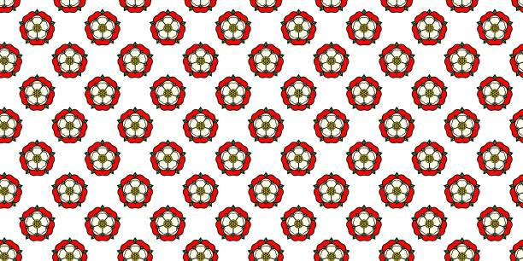
Humanities
During the first half of the term, we will complete learning about the Ancient Egypt. Each lesson will build towards children being able to explain the following statement:
Religion played a crucial role in the everyday life of an Ancient Egyptian and guided their decisions and actions. Agree or Disagree
Children will have learned about the River Nile, mummification, the Rosetta stone, pyramids, Gods and Tutankhamun.
Please feel free to take a look at these websites:
www.etoncollege.com/Heritage-collections
http://resources.woodlands-junior.kent.sch.uk/homework/Egypt.html
https://www.bbc.co.uk/teach/class-clips-video/articles/z2vmjsg
Then we will be learning about the Tudors, focusing on the Monarchs of the Tudor era. Each lesson will build towards children being able to answer the following question:
Henry VIII was the best Tudor monarch. Do you agree?
Children will learn about the different Tudor monarchs and their impact on life at the time and whether there is any lasting impact today.
In school, children will be exposed to a variety of high quality texts during their Topic lessons. There are many resources available for The Tudors, particularly in libraries and online.
Here are a few websites you could share with your child:
http://www.primaryhomeworkhelp.co.uk/Tudors.html
http://www.bbc.co.uk/schools/primaryhistory/famouspeople/henry_viii/
http://www.hrp.org.uk/PalaceKids/discover/allabouttudors
http://www.ngkids.co.uk/history/Tudor-Facts

Slide 6
Art/DT
Children will learn how about how to create tone using graded pencils.
They will work on creating still art pieces inspired by Michelangelo Caravaggio.
In D&T we will be designing, creating and evaluating a bag for a specific purpose when we will use a variety of techniques to join fabrics (including sewing!).
Music
The first half of the Lent Term, all the learning is focused around one Reggae song: Three Little Birds by Bob Marley. The material presents an integrated approach to music where games, elements of music (pulse, rhythm, pitch etc.), singing and playing instruments are all linked. As well as learning to sing, play, improvise and compose with this song, children will listen and appraise other Reggae songs.
During the second half of the Lent term, the children will learn The Dragon Song which is a song about kindness, respect, friendship, acceptance and happiness.
PE
Children will be doing Gymnastics and Dance.
The children will be developing their football skills, focusing on turning, how to beat an opponent, passing over a short distance and playing in small sided games. They will also develop their netball skills, working on their ability to pass the ball using a chest pass, jump stops and pivoting. These skills will then be put to the test in small sided games.

Slide 7
Additional Information
Reading
Please try to hear your child read at least four times a week and discuss the characters, events and key themes of the text. It’s better to read just a few pages and discuss them, rather than reading lots of pages. It is also beneficial for children to be read to by an adult, ideally once a week.
Please record any pages read in their Reading Record book and sign it. These are checked and signed by us on a Friday.
Reminders
Please continue to send a winter coat and appropriate shoes to school with your child.
PE
Year 3 PE takes place on:
Mrs Martinez and Mrs Kukla’s class on Monday and Thursday.
Mrs Iqbal’s class on Tuesday and Wednesday.
Please come into school wearing PE kit on your PE days.
Homework
Literacy and Maths homework is now issued online:
Literacy – Comprehension activities on ReadingEggspress. Please at least 1 lesson or 30 minutes.
Maths – Weekly tasks set on MyMaths.
Times tables practice on TTRockstars.
Learning weekly spellings
Reading 4x per week.
Login details are in your child’s Reading Record.
Sometimes creative homework may be set linked with specific areas of the curriculum.
Spellings
The children will receive a new list of spellings each Friday, which will be tested the following Friday. We suggest children use the Look, Cover, Write, Check method for learning their new spellings.
At the end of each half term children will be asked to revise the spellings from that half term for a ‘mix up’ test in the first week back.

Slide 8
Key Dates:
Walking to Church
Year 3 will be walking to Church on:
Tuesday 6th January at 10am
Teachers would appreciate any parent helpers who are able to walk to Church with the children.
Topic Days/Trips
Tudor Day is Friday 20th March
Hampton Court visit is on Friday 17th April.

