Slide 1
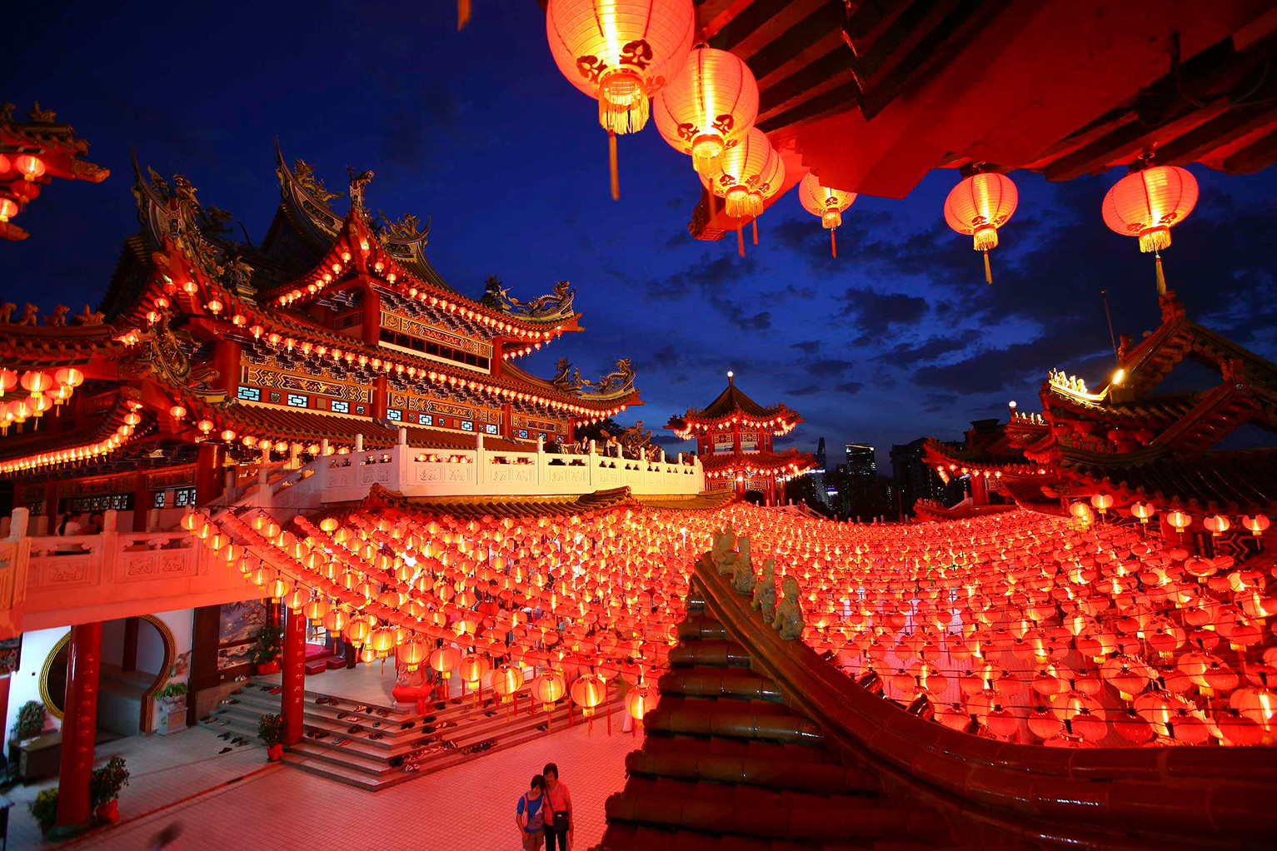
China
Year 2
Lent - 2026

Slide 2
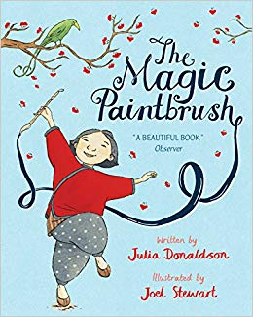
English (Lent 1)
Inspired by our book ‘The Magic Paintbrush’ we will be writing…
a character description of Shen, using similes, adjectives and adverbs.
a character description of a dragon, using similes, adjectives and adverbs.
a diary entry.
predictions of the story ending.

Slide 3
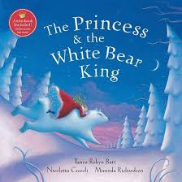
English(Lent 2)
Inspired by our book ‘The Princess and the White Bear King’ we will be writing…
predictions of the story ending.
a persuasive letter.
a diary entry.
our own story inspired the book.

Slide 4
Continued…
Spelling, Punctuation and Grammar
Nouns (common and proper nouns)
Imperative Verbs
Adjectives and noun phrases
Adverbs
Different forms of sentences: statement, question, exclamation, command
Continued from last term
Capital letters and full stops
Commas in a list and after fronted adverbials
Subordination: when, if, that, because
Fronted adverbials: first, next, suddenly etc.
Co-ordination: or, and, but
Past tense to mark actions in progress e.g. he was shouting
Suffixes
Apostrophes: contractions and possession

Slide 5
Key Vocabulary – English
Noun - a naming word for a thing, person, animal or a place. It can also be a feeling e.g. dog, man, love
Verb - a doing/action word e.g. running, walking, talking
Adverb - describes or gives more information to the verb e.g. quickly, smoothly, quietly
Adjective – a describing word e.g. Fluffy
Expanded noun phrase – a phrase that tells you more about the noun e.g. the fluffy, brown dog, the cat with the black and white nose
Simile-comparing one thing to another e.g. as brave as a lion
Imperative verb- verbs that command or give an order e.g. put, take, stir
Suffixes- a letter or group of letters added to the end of a word which changes its meaning e.g. nice becomes nicely, happy becomes happily

Slide 6
Maths
Multiplication and division
Show that the multiplication of two numbers can be done in any order (commutative) and division of one number by another cannot.
Recall and use multiplication and division facts for the 2, 5 and 10 times tables, including recognising odd and even numbers.
Calculate mathematical statements for multiplication and division within the multiplication tables and write them using the multiplication (x), division (÷) and equals (=) sign.
Solve problems involving multiplication and division, using materials, arrays, repeated addition, mental methods and multiplication and division facts, including problems in contexts.
Show that the multiplication of two numbers can be done in any order (commutative) and division of one number by another cannot.
Money
- recognise and use symbols for pounds (£) and pence (p); combine amounts to make
a particular value
- find different combinations of coins that equal the same amounts of money
- solve simple problems in a practical context involving addition and subtraction of
money of the same unit, including giving change
Fractions
- Recognise, find, name and write fractions, and of a length, shape, set of objects or quantity.
- Write simple fractions for example, ½ of 6 = 3
- Recognise the equivalence of ½ and 2/4.

Slide 7
Key Vocabulary – Maths
increase, together, and, more, sum, plus, add, total
difference between, subtract, decrease, reduce, take from, fewer, take
from, minus
multiplied by, multiply, product, groups of, lots of, times table, times
divided by, share, divisible by, share equally, divide, divide into, group

Slide 8
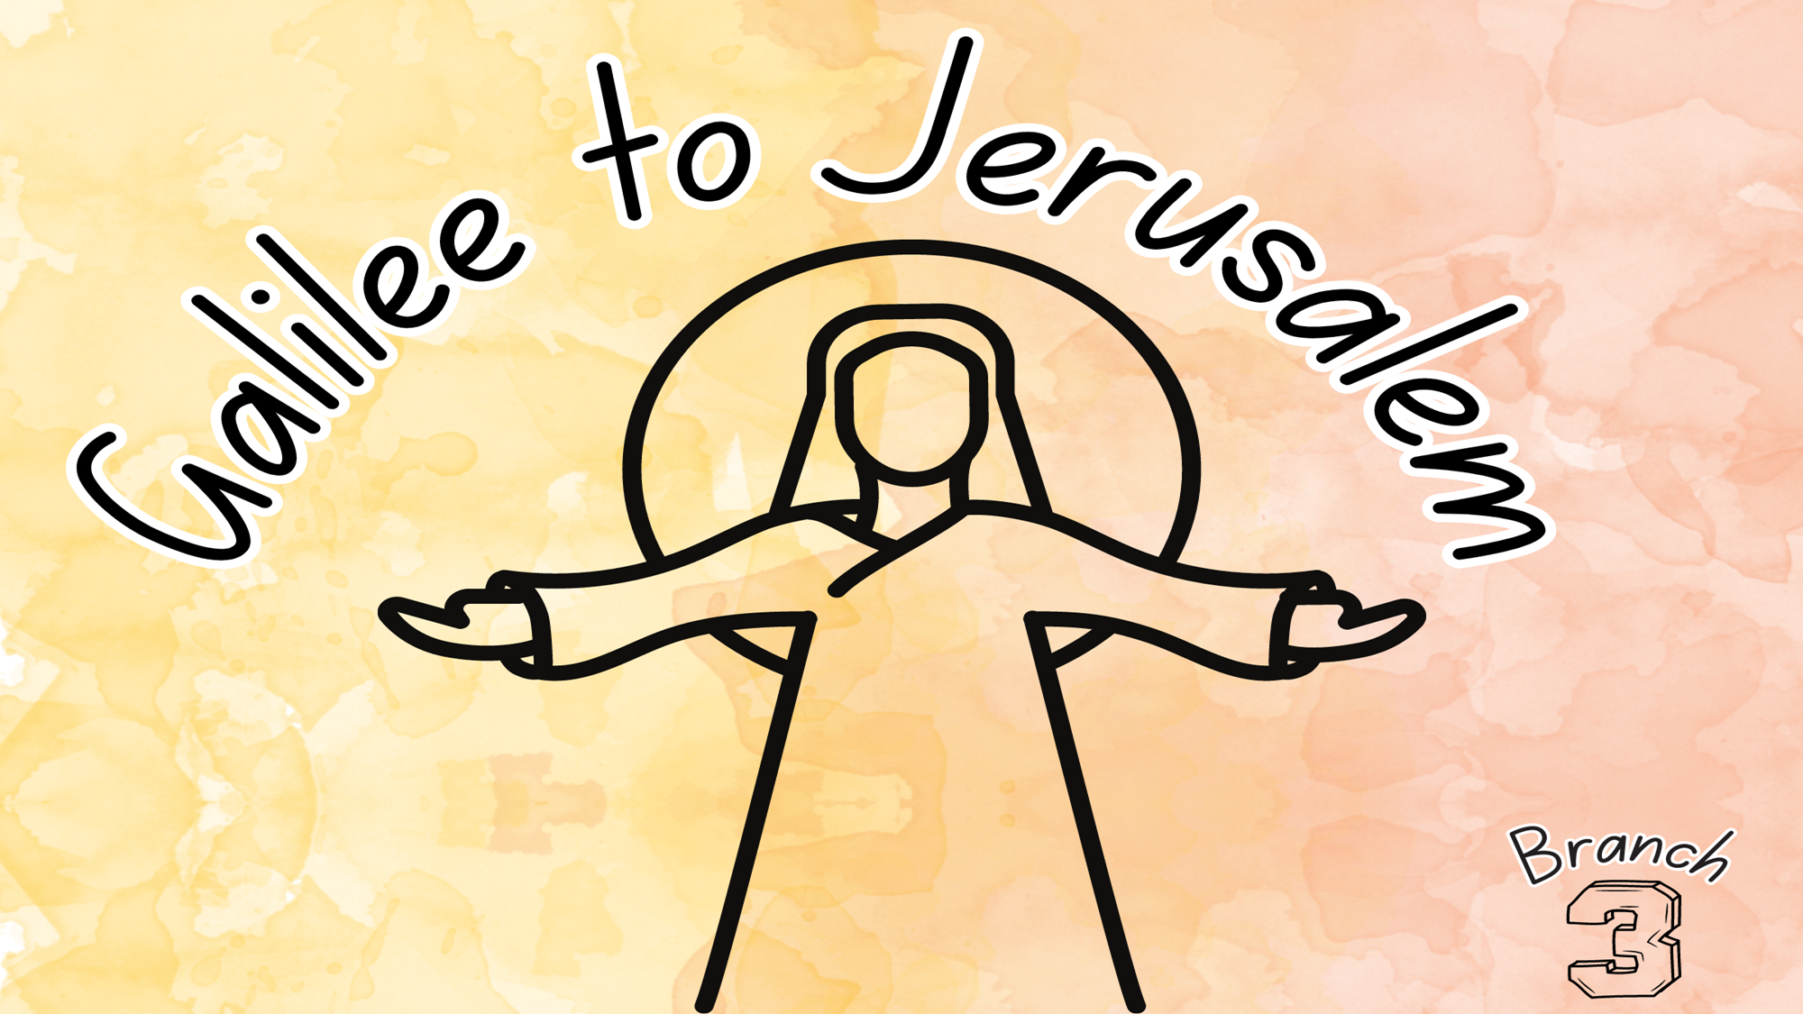
RE
To retell the story of John the Baptist and the baptism of Jesus
Begin to recognise ‘parables’ as a literacy form in scripture with reference to the parable of the lost sheep (LK 15:4-7) and how Jesus uses them to teach people about God.
Recognise that everyone is tempted to make bad choices (sin), but that God loves and forgives all people
Begin to recognise that the miracles of Jesus are signs that He is the Son of God.
Correctly use religious words and phrases to recognise how Catholics say sorry to God in prayer and talk about why saying sorry to God and to others is important.

Slide 9

RE
Recognise what Jesus said on the cross about forgiveness and make simple connections with the belief that God always forgives us.
Correctly use religious words and phrases to talk about the symbols of light and water in the Easter Vigil Mass.
Recognise that Lent is a time for reconciliation and forgiveness.
Correctly use religious words and phrases when describing in an age-appropriate way the Sacrament of Reconciliation, making simple connections between the sacrament and a belief in God’s forgiveness.

Slide 10
Science
Materials
We will be learning about…
identifying what material different objects are made from.
identifying and grouping everyday materials.
comparing the suitability of materials for different purposes.
Key Vocabulary for Science topic of Materials
Materials - from which something is made
Compare- to see the likeness and differences in things
Suitability- having the right property for a purpose e.g. a window made out of glass
Properties- how something is described and identified
Purpose- what an object is used for
Recycling- process of turning some thing that would be thrown away into something new

Slide 11
Topic
Geography (Lent 1)
We will…
describe a place outside Europe using geographical words.
understand where China is in the world.
find out about London and compare it to Beijing.
add labels to aerial photographs to recognise landmarks and basic human and physical features.
identify geographical similarities and differences between where they live with an area in China.
learn about significant landmarks in China and the impact of tourism.
use maps and atlases to improve our locational knowledge.
investigate the population density of China.

Slide 12
Key Vocabulary – Topic
Similarities – how things are the same
Differences- how things are different
Human Feature- how a country has been changed by people
Physical Feature- natural features such as rivers and mountains
Continent-one of Earth’s seven main divisions of land: Asia, Africa, North America, South America, Antarctica, Europe and Australia
Climate – the average weather conditions for a particular place over a period of time.

Slide 13
History (Lent 2)
The Battle of Hastings and the Norman Conquest
Using the Bayeux Tapestry as a primary source of evidence
Creating a timeline of the events leading up to and after the Battle of Hastings
Norman Castles – motte and bailey & keep and bailey
The Structure of a Medieval Castle
How were Medieval Castles defended?
Who lived in a Medieval Castle?
What jobs did people do in a Medieval Castle?
Is it important that we still have castles from the past? Do you agree?

Slide 14

Art / DT (Lent 1)
We will be creating…
To explore texture and tone using different media.
Chinese New Year puppets (sewing)
To use knowledge of existing products to help come up with ideas.
To develop and communicate ideas with increasing detail by talking and drawing.
To select with increasing accuracy from a range of materials and components according to their characteristics.
To measure, mark out, cut and shape materials and components. Use the finishing techniques.
Use the correct technical vocabulary.
Know that a 3D textiles product can be assembled from 2 identical fabric shapes.
Make simple judgements about their products and ideas against design criteria then suggest how their products could be improved.

Slide 15
Art/DT (Lent 2)
We will be creating…
Clay coil pots inspired by Magdalene Odundo, An artist from Kenya.
Children will learn coiling techniques and use clay tools.

Slide 16
Computing
We will use Scratch Jr on the iPads to understand that sequences of commands have an outcome, and make predictions based on their learning. They use and modify designs to create their own quiz questions in Scratch Jr. They will also evaluate and improve their work.
In Espresso they will learn that programs respond to different sorts of inputs, and that the keyboard can be used to control objects on screen, not just by clicking them directly. Then use other objects for control.

Slide 17
Music
In the first half of the Lent Term, the children will learn the unit song 'I Wanna Play In A Band.' This is a Rock song written especially for children. In this song, they will learn about singing and playing together in an ensemble.
As well as learning to sing, play, improvise and compose with this song, children will listen and appraise classic Rock songs.
After half term, the children will be learning about Reggae music. All the learning is focused around one song: Zootime. The material presents an integrated approach to music where games, the interrelated dimensions of music (pulse, rhythm, pitch etc), singing and playing instruments are all linked.

Slide 18
Homework
Children will have a reading book. Children should read 3 to 4 times a week. Please sign to say they have read.
Homework & spellings will be set every Friday and will be stuck into the reading diary.
MyMaths & Reading Eggs must be completed by the following Wednesday.
Log in and practise times tables using TTrockstars.
The spelling test will take place every Friday morning.

Slide 19
Additional Information
Dates for your diary:
Thursday 12th February - Year 2 China day
Friday 30th January – Year 2 trip to Windsor Castle
Thursday 12th March 2026 – Optional Parents Meeting

Slide 20
Additional Information
PE
Year 2 PE lessons are:
Tuesday and Wednesday – Mrs Powell’s class
Tuesday and Friday – Miss Macfarlane’s class
Reminders
On PE days, please send your child to school wearing their PE kit.
Please continue to send a winter coat and appropriate shoes to school with your child.
If your child has shoes with laces please spend some time showing your child how to tie them.

Slide 21
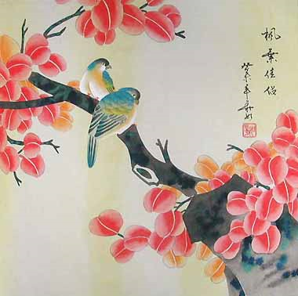
Events
China Day – Thursday 12th February
We will have a China Day enrichment day. The children can come to school dressed in something red or yellow or Chinese clothes. During the day we will do lots of fun activities including, learning about Chinese New Year and some of the traditions associated with that and eating a delicious Chinese meal for lunch.
Letter will be shared prior to China Day with additional information.

Slide 22
Events
Trip to Windsor Castle – Friday 30th January
To introduce the history topic about Castles, the children will visit Windsor Castle for their school trip. This will be an opportunity for the children to experience an interactive workshop where they will learn how castles were first built. They will also have the opportunity to visit St. George’s Chapel and see the State Apartments.
Letter will be shared prior to Windsor Castle Trip with additional information.

