Slide 1


Slide 2
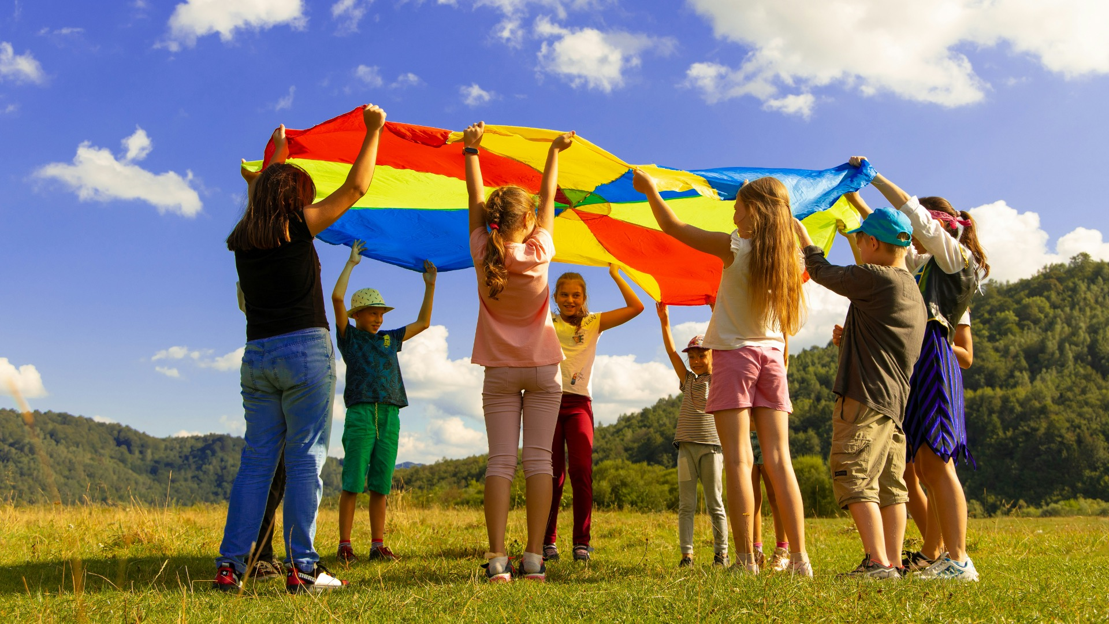
Where can accidents happen?

Slide 3
Where can accidents happen?
🏠 Home
🛝 Playground
🚶 Road
🏞️ Park
🚌 On the way to school
Can you think of a place where we need to be extra careful?

Slide 4
Road safety rules
👀 Stop, Look, Listen, Think
🚦 Use crossings and traffic lights
👫 Hold hands with an adult
🛴 Be careful with bikes/scooters near roads

Slide 5
Stranger danger

Slide 6
Stranger danger
Never go anywhere with someone you don’t know 🚫
If you feel unsafe: shout, run, tell 🚨
Always tell a trusted adult

Slide 7
Who can help you stay safe?

Slide 8
Who can help you stay safe?
👨‍🏫 Teachers
👩‍👩‍👧 Family
👮 Police
👷 Safety officers
🧑‍⚕️ Nurses and doctors

Slide 9
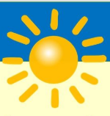

Slide 10
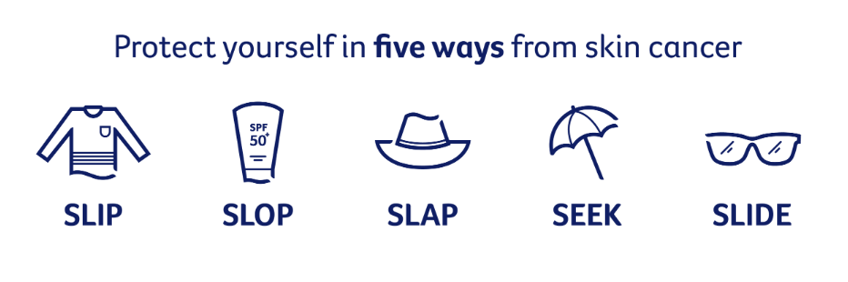

Slide 11

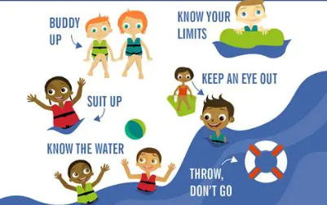

Slide 12
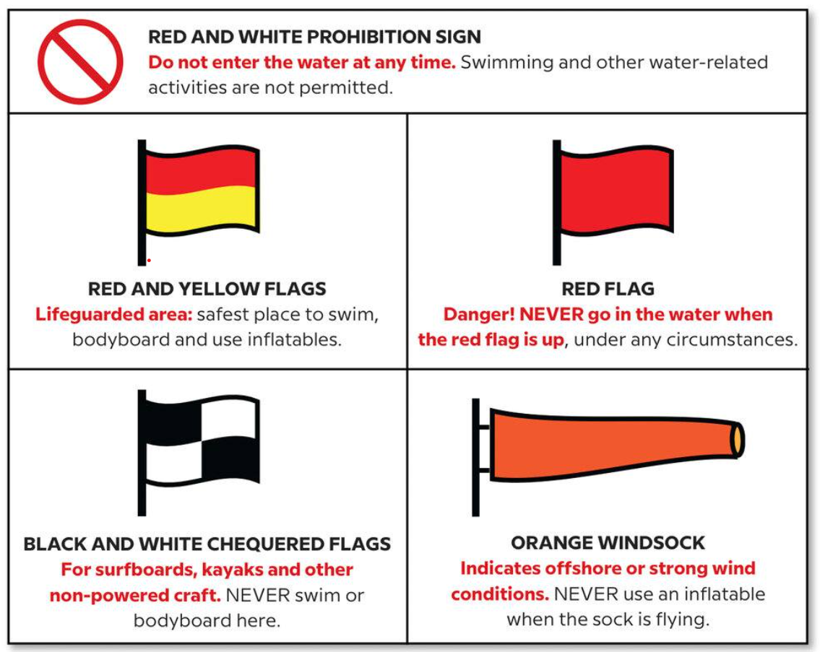

Slide 13
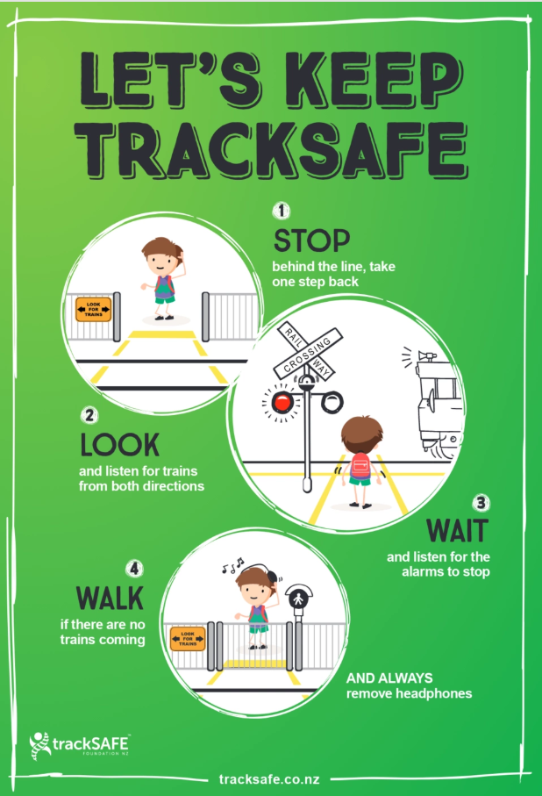


Slide 14


Slide 15
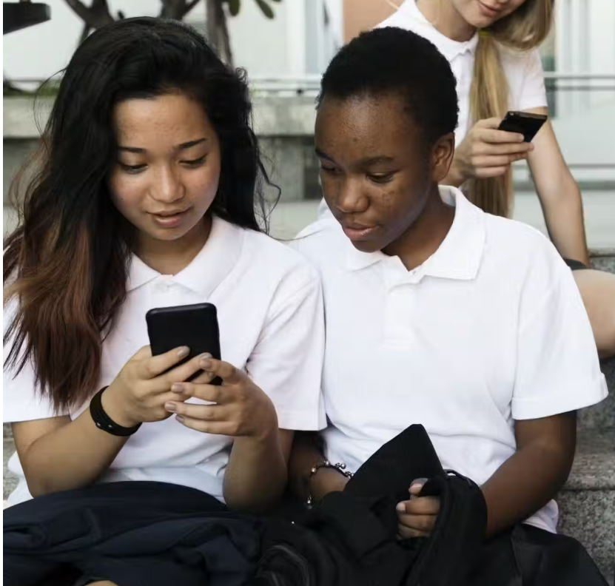

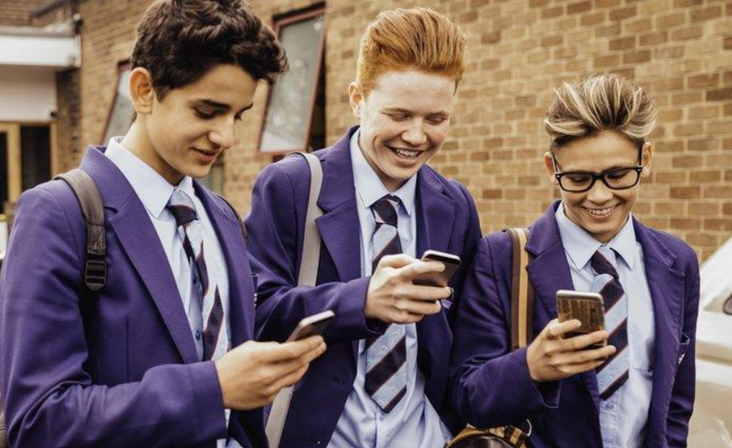


Slide 16


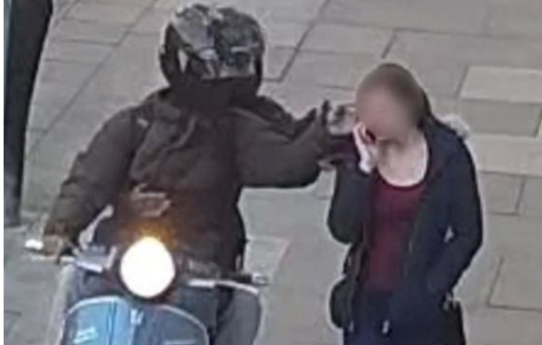


Slide 17


Holy Family Staff
Visitors
Visitors

Slide 18
