Slide 1
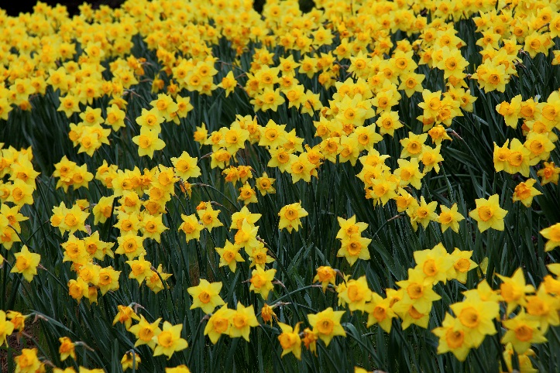
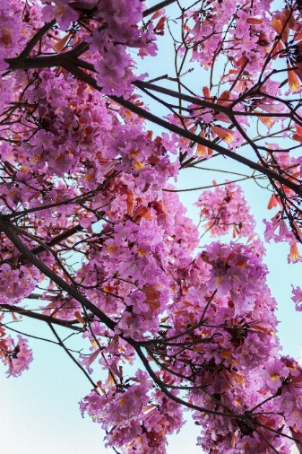
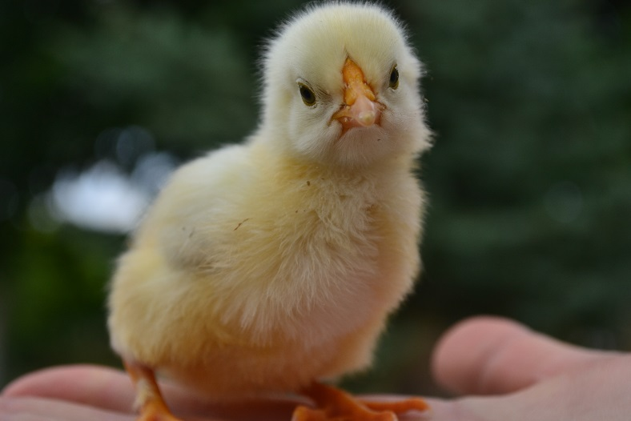

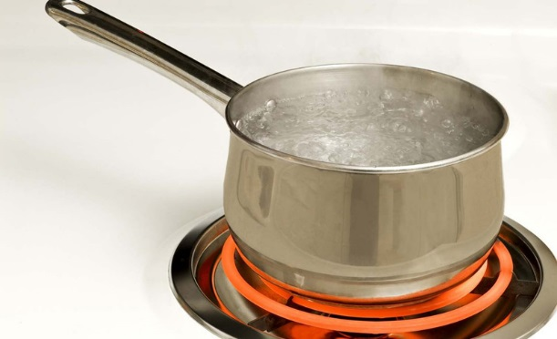
Reception’s curriculum map Lent Term 2 2026
‘Changes’

Slide 2
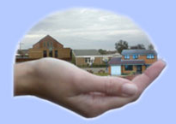
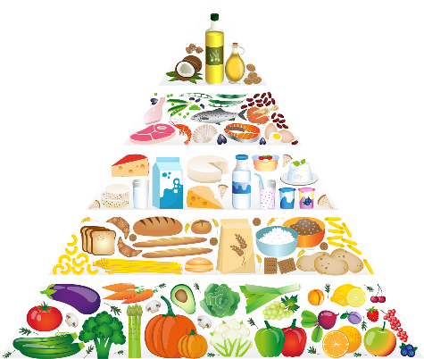
Prime Areas of learning
Physical Development
This term, every Tuesday morning the children will be taking part in their PE lesson where there will be a range of physical activities. The children will be encouraged to move with confidence and control in both large and small movements. They will also be practising a range of skills to learn about spatial awareness through experimenting with different ways of moving.
Each day, around the classroom, the children will have access to a range of fine motor activities to develop the muscles in the hands e.g. playdough, using cutlery at lunchtime, threading activities, colouring, Lego etc. This will in turn help their handwriting and how they form their letters.
We will be partaking in regular handwriting practise, encouraging the children to use the cursive style of handwriting as well as a correct pencil grip to get them to start joining up their sounds within words.
Personal, Social and Emotional Development
During this term the children will be encouraged to try new activities and select activities and resources independently. We want to motivate each child to become independent within their learning and well as displaying resilience and perseverance in the face of difficulty.
We will learn to work together to develop ideas, contribute suggestions and listen to what others have to say. The children are beginning to be aware of different emotions and feelings and how actions can impact on others. We will talk about various emotions and how to cope with these through role play situations.
We will be expecting the children to have developed greater attention skills. They should be able to listen to what the teacher says, respond appropriately even when engaged in an activity, and be able to show the ability to follow instructions involving several ideas or actions.
When talking about changes in relation to our own bodies and growing up, we will discuss and explore the idea of healthy eating and making healthy food choices.
Communication and Language
This term our main story is going be Jack and the Beanstalk. Through the exploration of this story the children will have various opportunities to re-enact the stories and talk about various key themes. Ask your child to re-tell the story at home. The children will be encouraged to listen and respond with appropriate comments about the story in full sentences. They will be given opportunities to comment on what they have heard and allowed to ask questions to clarify their own understanding.
The children will also encounter a range of different fiction and non-fiction books about Spring. They will be linking the facts they have learnt through the books to create their own non-fiction books and role play their thoughts and ideas.

Slide 3

Specific Areas of learning
Mathematics
This term, we will be continuing to learn about numbers in depth to 10 and beyond if necessary. The children will continue to think about recognising amounts in different contexts and subitise so that they are recognising amounts without having to count them out e.g. recognising 6 straight away on a dice.
The children will be thinking about the composition of numbers to 8, 9 and 10 and beyond and how they can form simple addition and subtraction sentences to show their understanding. They will also have the opportunity to recap 1 more and 1 less than numbers to 5 and apply this to numbers to 10. The children should be able to recall number bonds to 10, at pace by the end of this term.
Linking to our learning of Jack and the Beanstalk and ‘Changes’ we will also talk about comparing length, height and time.
The children will also be exploring 3D shapes and their properties.
Please find some websites below which support mathematical skills. http://www.ictgames.com/resources.html
www.topmarks.co.uk
http://www.bbc.co.uk/learning/schoolradio/subjects/earlylearning
Literacy
Read Write Inc. will be carried out every day for half an hour. Please continue to support your child at home with their reading and letter formation. We will be encouraging the children to use their phonic knowledge to write simple words and sentences independently. The children are constantly gaining confidence in blending sounds together to read unfamiliar words as well as reading words they recognise by sight (or blending in their heads). To improve their writing skills the children will use their phonic knowledge to access a range of different types of writing e.g. recipes, stories, lists, cards etc.
One of the main stories we will be exploring this half term is Jack and the Beanstalk so the children will have various writing opportunities linked to this story.

Slide 4



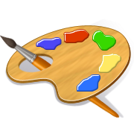

Understanding the world
We will be learning all about the natural world around us, taking inspiration from our theme ‘Changes’. The children will be making observations of our outside environment to see if they can start to find signs of Spring. We will discuss how the weather differs from the other seasons and the activities that are suitable for Spring e.g. gardening. We will continue to think about how nature develops and grow our own sunflowers.
We will also be talking about past and present and remembering how much the children have grown since being a baby and what has changed in their lives since then.
Religious Education
During this term, the children will be focusing on Branch 4 ‘Desert to Garden’. In this topic the children will discuss Shrove Tuesday and Ash Wednesday and mark their significance, during Lent as we prepare for Easter. We will be thinking about what living things need to help them grow. We will then link to people growing in their faith and growing to be more like Jesus.
We will have weekly assemblies, presenting the Stations of the Cross during Lent and as a class we will be making our own Lenten promises.
Towards the end of our topic we will think about the importance of Easter and how Jesus dying for us allowed him to then rise again and prove he was the Son of God.
Expressive art and design
The children will be representing their own ideas, thoughts and feelings through making their own spring pictures using a range of different media and materials.
We will continue to give the children opportunities to role play stories, situations and occasions to develop their story telling and drama skills. We will continue to exploring sounds and songs through singing and experimenting with different materials. The children will also get the opportunity to make props to support their role play using various forms and functions.

Slide 5
Additional Information
In order to support your child it would be helpful if you could encourage them to…………
- Recognise their name when finding their pegs/drawers.
- Be putting their shoes and slippers on themselves.
-Be using a knife and fork when they eat their dinner.
-Dressing and undressing themselves.
-Put their own coats on and begin to use the zips or buttons themselves.
-Recognise two digit numbers within their everyday environment.
-Write their own name in the cursive style.
-Tidy up after themselves
-Wipe their own noses.
Below are a list of diary dates, if these change at all for any reason we will let you know.
23rd February: Children start back
2nd March: St. David’s Day (wear yellow)
5th March: World Book Day- dress up as favourite book character.
17th March: St Patrick’s Day (wear green)
30th March: Break up for Easter holidays

Slide 6
Golden Time- Every Friday children will have 25 minutes of golden time where they have access to different activities that they do not get to use throughout the week. Alongside golden time we have behaviour steps which the whole school follows. If the children are warned three times about a certain behaviour on our behaviour steps they then have to go and sit by our sad face and move one of their smiley faces to a sad face. Each child has a picture with 5 smiley faces on and each smiley face represents 5 minutes, so if they lose a smiley face they lose 5 minutes. Throughout the week they will not get a chance to earn this time back, once it’s gone it’s gone! Each Monday we start afresh and it is a clean slate for the children.
RWI books- Once your child knows all their set one Read Write Inc. sounds confidently and are beginning to blend their sounds, they will be given a Read Write Inc. book to take home for the week. They are the same books that your child will be reading in school however we also will be doing writing to go alongside this book hence why the same book is kept for the week. We ask that you keep the books in their blue book bags in case we do end up finishing the book sooner/later than the week. Please help your child to go through their sounds and story every night to ensure maximum progression.
Library books- every Tuesday your child will choose 1 library book to take home for the week. This is not necessarily for your child to read however if they want to then great! It is more an opportunity to encourage reading and looking at stories at home and having fun with books. Please ensure the children have them in their book bags every Tuesday for them to swap for another book. Whenever you read a book at home, please record it in their reading diaries.
Useful information
Please ensure ALL of your child’s belongings are named.
Book bags need to be brought in every day.
Children should arrive in their PE kits on a Tuesday morning for Mrs Harris’ class and for Mrs Scott’s class.
Star of the Week- Each Friday our class monkeys will choose a new star for the following week. They will be able to take their class monkey home for the weekend and write about their adventures in the book provided. Every child will get a go at being star of the week at some point in the year.
Rainbow of rewards- the children start with their picture on the cloud, if they do something exceptional, behave very well or use excellent manners they will be moved up one colour of the rainbow. If your child is on the sun by Friday they will be able to choose a special treat from our treat box.
Show and Tell- children will be able to bring in one small item to show their class on their allocated day. There will be a basket for your child to put their show and tell item in when they come into the class in the morning.

