Slide 1
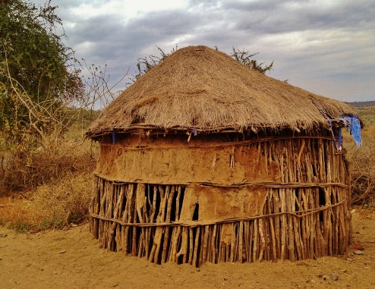
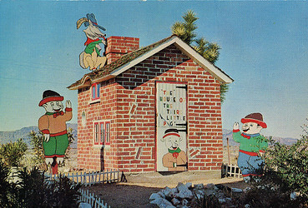
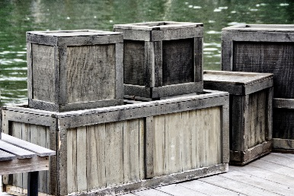
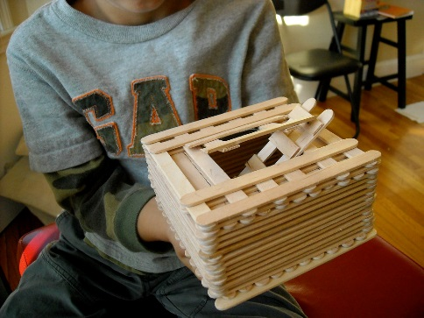
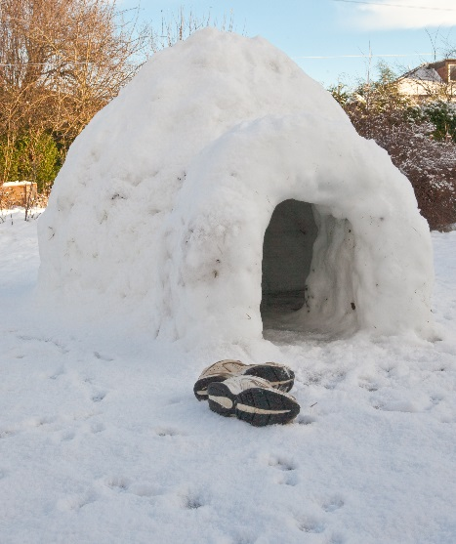
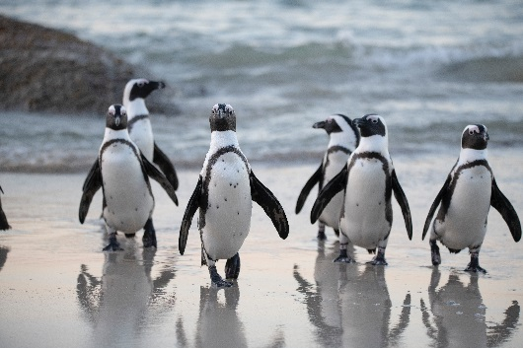

Nursery
Lent term 1
Curriculum map
Materials
RE topics: Galilee to Jerusalem
.

Slide 2
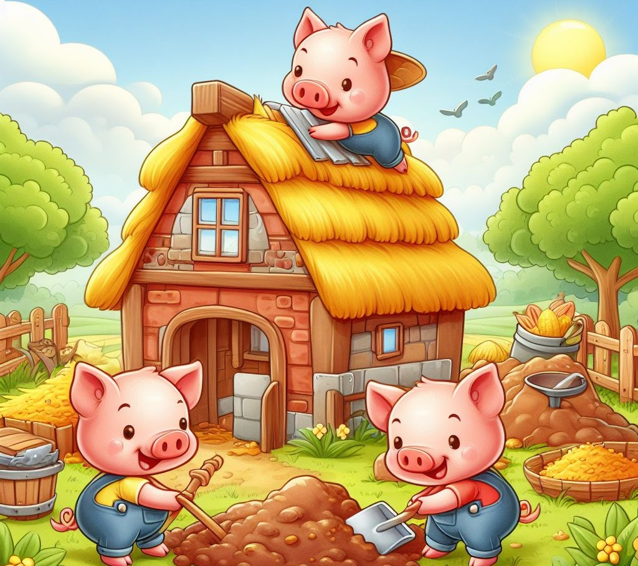
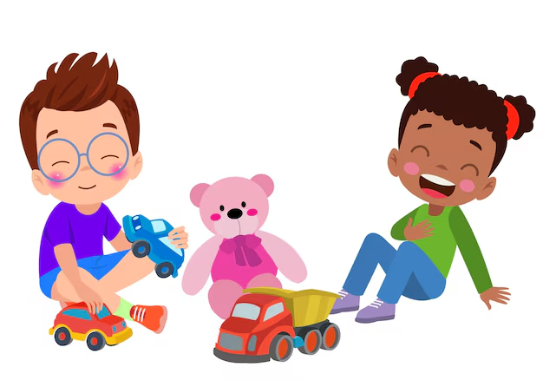
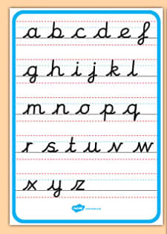

Prime areas
Personal, Social and Emotional Development
Now your children have settled well into the rules and routines of Nursery, we will now continue to develop their self-confidence and independence.
We will continue to demonstrate and talk about how to form positive relationships with others including turn taking and talking about our feelings rather than showing them through unkind words or actions.
We will also be demonstrating how to extend their play by elaborating play ideas, e.g. building up a roleplay activity with other children.
Communication and Language
Children will be encouraged to speak and communicate both with their peers and adults all the time. Adults will question children and share with them their own thoughts to further children's thinking, which they will then be encouraged to verbalise.
They will be immersed in a rich language environment, where they will hear and be taught a large range of vocabulary.
Linking to our topic of Materials, the children will spend a lot of time learning the story of The Three Little Pigs, as well as Stanley’s Stick. They will try to remember the story lines, practise re-telling the stories, and sequence them. The children will have to demonstrate their understanding of new vocabulary by following our instructions and responding to questions, as well as using it in context while playing and exploring. For example they may talk about different materials we can use to make houses while using the construction resources outside.
The children will also continue to learn some new nursery rhymes, and begin to think about how some words ‘sound the same’. Children will be encouraged to join in with reciting the rhymes and accompanying actions.
Physical Development
We will continue to provide the children with all the same resources and activities as Autumn term however, we will begin to focus even more on encouraging a correct and efficient grip using mark making tools, and the confidence to write letters and numerals independently. We will be writing the phonic sounds as we learn them as well as our names. Alongside this we will provide many resources that will help to strengthen their fine motor control.
Children will access a range of resources which will include developing their core strength, and balance. They will have obstacles to move over, around or through, practise their throwing and catching skills and find different ways of moving, climbing and using their gross motor skills.
We continue to educate children about the differences between healthy foods and treats, and encourage them to be independent in accessing water throughout the day. They are still provided with a choice of milk or water, and fruit, at snack time,

Slide 3


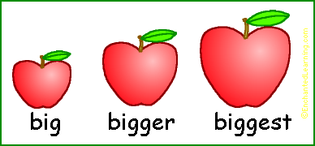
Specific Areas
Literacy
Children will continue to choose books from our borrow a book library box for them to enjoy at home. Please feel free to write any stories, that you share together at home, in your reading records so that we can see how much you are reading at home.
Our topic about Materials lends itself nicely to some lovely stories such as The Three Little Pigs, Hodge, Podge Lodge and Stanley’s Stick, amongst others. We also use non-fiction books to look at different types of materials, and how they can be used.
Children continue to enjoy and participate in our daily story time. They are asked what they think might happen next, or how they think the story might end? Through using big books, children will be able to see that we start reading from left to the right, top to bottom, and we turn one page at a time. We will also sing lots of songs and enjoy Nursery rhymes.
We will begin to teach the set one sounds using the Read Write Inc. programme and the children will be taught how to say, write and recognise each letter.
Mathematics
The children will begin to focus on numbers 3, 4 and 5, developing a strong knowledge of these numbers being able to recognise, write, count and subitise.
Children are taught how to show these numbers in various forms for example 4 apples could be placed like they are shown on a dice or 4 in a vertical line etc. We also learn about the composition of the number such as how we can make 4, and we learn to recognise the numeral. Children are also encouraged to say how many items they can see without counting them (subitise).
While reading Stanley’s stick children play with sticks and look at different sizes, using vocabulary such as short, long, tall, small.
Much of your children’s mathematical development will take place through practical activities such as games using dice, counting objects or actions, using dominoes, number and shape puzzles, construction using shape and many other resources.
The following online games are very good for the children to use to consolidate their knowledge on size and counting.
https://www.topmarks.co.uk/maths-games/3-5-years/measures
Learning to Count up to 15 with Teddy Numbers Interactive Maths Game (topmarks.co.uk)
This Photo by Unknown Author is licensed under CC BY-NC-ND

Slide 4

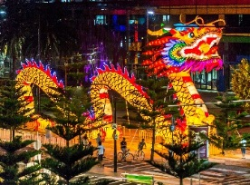
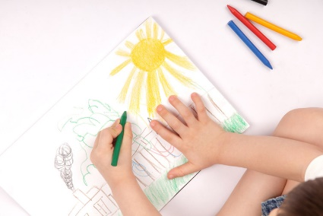
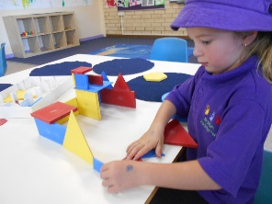
Religious Education
The children will learn about how the 3 wise men visited baby Jesus.
We use gospel stories such as Jesus asking the children to come to him, and Jesus feeding the 5000, to show how he is a friend to us all, and how we can learn from him and be more like him.
Children make fish and bread using malleable resources like clay and play dough, they act out the stories and even make a soup kitchen when thinking about how we can help others and share what we have with others.
Children will continue to learn their morning, lunchtime and home-time prayers as part of our daily worship.
We will learn about, and celebrate St Valentine as part of our Valentine's day activities.
Understanding the world
This term we will be exploring materials. We will talk a lot about the different types of materials and what we can use them for. We look at different materials in our environment and consider why that material was used.
We will also be talking about the season of Winter.
We discuss the weather and the conditions, using ice to experiment with. We look at what type of housing would use ice and where we might find igloos.
Linked to this we look after our class cuddly penguin which hatches from an egg in our Nursery, and learn about where he may live.
Linked to our story The Three Little Pigs, we look at where we live and many different types of homes such as flats, bungalows, boat houses, and consider what they maybe made from.
We will have lots of time to discuss family traditions and how everybody celebrated Christmas with their families, as well as learning about celebrations such as Chinese New Year, Pancake Day, and Valentines day.
Expressive art and design
While children have a range of resources to build and design from freely, they will be questioned about their choices and prompted to assess their progress and development in the task. From here they can continue or change the way they are working or the tools and equipment they are using. They will be encouraged to develop their own ideas and explain why they have chosen the materials they have.
Role play and small world play will be modelled and children will be encouraged to bring their own experiences into their play as well as using their imaginations.
Mark making tools are available to children all day and they are gradually encouraged to explain their drawings and marks, and add more detail, for example to show emotions or movement.

Slide 5
Additional Information
Useful Information
Nursery times
Morning: 9.00 until 12.00 midday
Afternoon: 12.00 until 3.00 pm
Full time: 9.00 – 3.00 pm
Early Birds Club: 8.30-9.00am
Sunset Owls Club: 3.00-3.30pm
Additional wrap around care is available through Julie.lynch@hfcs.org.uk for the following hours:
Rising Robins: 7.45am – 9am
Sleepy Sparrows: 3pm - 4.30pm or 3pm – 5.45pm
Blue School bags
The children’s blue school bags need to come into school every day.
Our lending library is set up and reading diaries will be checked every Monday.
We will also provide you with a weekly ‘Go Home Sheet’ that will explain everything we have learnt in that week and for you to support children's learning at home.
Links to support the teaching of phonics will be added to the schools newsletter.
In order to support your child with their learning, it would be useful if you could:
Look for shapes and numbers all around you e.g. if you are walking to the shops you could look for door numbers, car registration plate, street signs etc.
If your child starts to write letters or words encourage a correct pencil grip, and if they are writing their name use a capital letter for the first letter only.
Important dates for the diary
19th January: INSET DAY: No Nursery
10th February: Stay and Play (11.15-11.45am & 2.15-2.45pm)
16th February-20th February: Half Term

